Slide 1
Intelligent Training Systems
Stottler Henke’s Capabilities, Applications, and Tools
This Powerpoint presentation is best viewed as a Slide Show.
20240923
Notes:
Press the page up/down key to go to the previous/next slide.
The slides are set up to transition automatically between slides using a timer. Total run-time is about 11 mins.
To disable auto transitions, in Powerpoint, select:
Slide Show / Set Up Slide Show
Select radio button: Advance Slides = Manually.
To skip over some slides, in the overview pane at left, right click on the slide's thumbnail and select "Hide Slide" from the context menu (vs. deleting slides) so that we don’t proliferate versions of this file with different subsets of the slides.

Slide 2
Stottler Henke’s intelligent training systems for complex skills encode expert knowledge to provide highly effective learning experiences with precise assessments and interventions.

Slide 3
Intelligent Training Capabilities
Intelligent Tutoring Systems | Emulate expert instructors to provide the benefits of one-on-one tutoring - automatically and cost-effectively.
Intelligent After-Action Review | Select, analyze, and present key exercise events to help instructors conduct more effective AARs.
Intelligent Simulations | Complex behaviors of teammates, computer-generated forces, etc. provide challenging and realistic learning experiences.
Authoring Tools | Enable the development of intelligent tutoring systems and complex simulation behaviors more quickly and easily.

Slide 4
What Do Intelligent Tutoring Systems Do?
During scenarios, ITSs:
Evaluate student actions (simulations) or utterances (tutoring dialogs) to assess their knowledge and skills, and
Provide coaching and focused, context-sensitive feedback
(hints, questions, and prompts which guide reflection.)
After scenarios, ITSs report fine-grained student performance, suggest remediations, and select next exercises for individualized learning.
ITSs complement direct instruction:
Traditional classroom instruction, readings, and CBT instill knowledge.
Scenario-based ITSs prompt students to apply that knowledge.

Slide 5
Simulations and Tutors Create Experts
Traditional computer-based training creates trained novices
Direct instruction and multiple-choice questions:
Test simple skills and
Provide coarse assessments of student knowledge and skills.
Scenarios prompt students to apply knowledge
Assess diverse situations, generate solutions, and make decisions.
Intelligent tutors complement training simulations
Simulations respond to student actions, providing natural feedback.
Student actions provide rich data to the Tutor to support precise, fine-grained assessments and focused interventions.
Tutors prompt students to reflect on their decisions and actions and relate them to simulation outcomes.

Slide 6
Stottler Henke
Intelligent Training Systems
Applications

Slide 7
Tactical Action Officer ITS
Improves tactical proficiency of student Tactical Action Officers (TAOs)
Enhances Northrop Grumman’s Watchstander simulation with:
Intelligent automated friendly and enemy forces,
Speech-enabled automated teammates, and
Adaptive hinting/feedback via intelligent tutor and teammates.
Version 1 – U.S. Navy SBIR Success Story
Version 2 – Used for 10 years at SWOS
U.S. Navy SBIR Success Story.
Stottler Henke Intelligent Training Systems
Dept of Defense photo

Slide 8
FSMs Track Student, Control Sim and Tutor
Finite state machines (FSMs):
Track student actions in context of simulation events and states,
Control simulated entities (platforms, teammates), and
Control tutor (e.g., hinting).
FSM = network of:
States (rectangles),
Transitions between states (arrows),
Test conditions/situations (ovals).
SimBionic agent toolkit supports:
Hierarchical, parallel FSMs and
Integration w/ sim, tutor, databases
Wait for Attack
incoming missile?
proper defensive action taken?
Under Attack
timeout?
missile destroyed?
Principle
Failed
Principle Passed
Principle
Untested

Slide 9
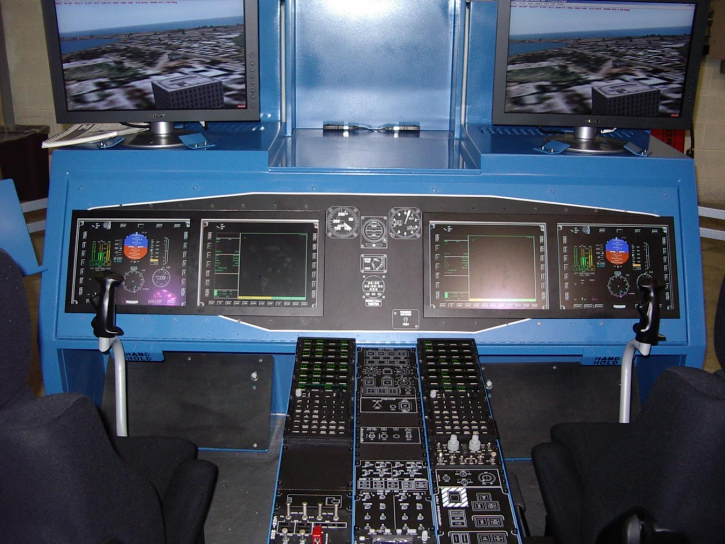
OMIA: Helicopter Cockpit Training
Easily deployable simulator teaches pilots, co-pilots, and sensor operators the common-cockpit used by U.S. Navy MH60R and MH60S helicopters.
Deployed at all training and fleet squadrons in the US and around the world.
Enables anytime, anywhere practice-based training.
Has saved the Navy tens of millions of dollars in simulator and flight costs.
U.S. Navy SBIR Success Story.
Dept of Defense photo

Slide 10
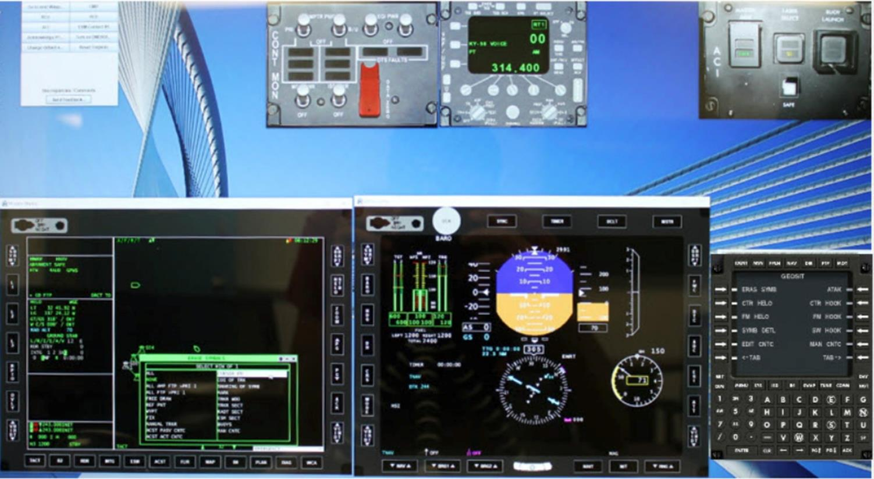
OMIA Helicopter Cockpit Training Simulator

Slide 11
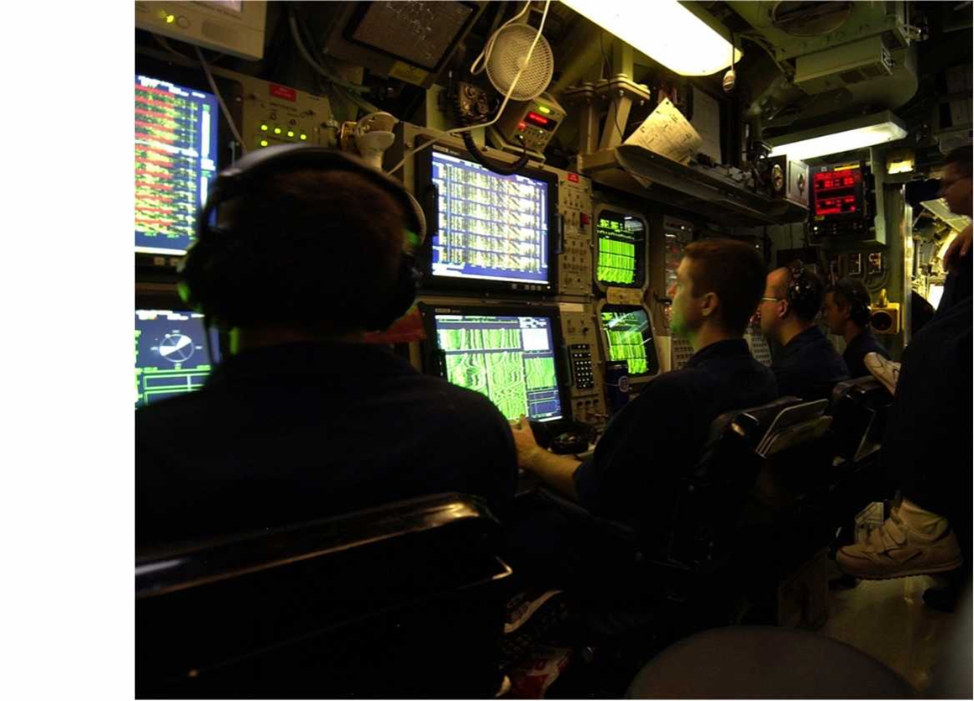
AAITS Acoustic Analysis ITS
Enables U.S. Navy sonar technicians to practice sonar data analysis to detect and classify targets in diverse scenarios.
Students identify and annotate sonar data displays with sound sources and features, relationships among the features, and target classifications.
AAITS compares student’s detailed annotations with the expert’s to assess and report each student’s performance.
Used at 10+ Navy sites. U.S. Navy SBIR Success Story.
Dept of Defense photo
Notes:
An important responsibility in the U.S. Navy is monitoring sonar data to detect and classify submarines. Passive sonar data is radiated through the water from sound sources on board the submarine. This is different from active sonar which are pings that are reflected by the submarine. Analyzing passive sonar data is hard because the ocean is full of noise, echo, and reverberation, and submarines are designed to be quiet.
Sonar technicians analyze sonar data by looking at images that show the data graphically, so that the brightness of the image shows the signal strength of the data at a particular frequency and point in time. By looking for visual patterns in the image, sonar technicians can detect and identify sound sources that are characteristic of different types of submarines.

Slide 12
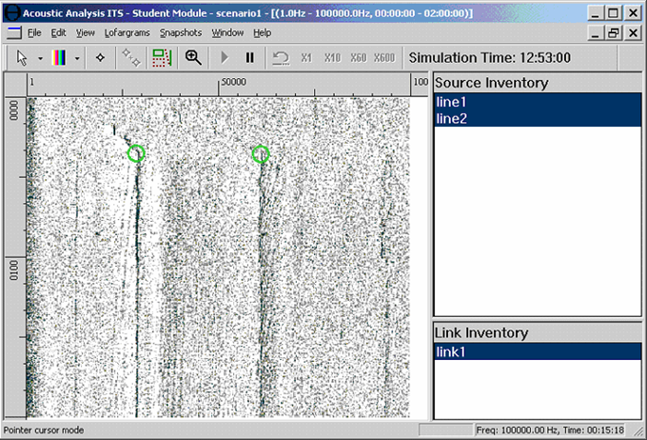
AAITS Annotation Editor Captures Student’s Sonar Data Analyses
SONAR feature annotations
Notes:
We developed a system called the Acoustic Analysis Intelligent Tutoring System that lets sonar technicians practice analyzing sonar data and receive automated feedback on their analysis.
The software displays a set of sonar data images and lets the student annotate the sonar data with what they see and what they infer. That is, the system lets the student enter the type of submarine they think is shown in the data, along with everything that they see and figure out that supports their answer.
For example, they can click on places in the image that show significant sound sources, and they can link sound sources that are related. Students can also enter visual characteristics of each sound source, as well as the reason why they consider linked sound sources to be related. They can also select the type of submarine they think is shown in the data and the reasons for their decision.

Slide 13
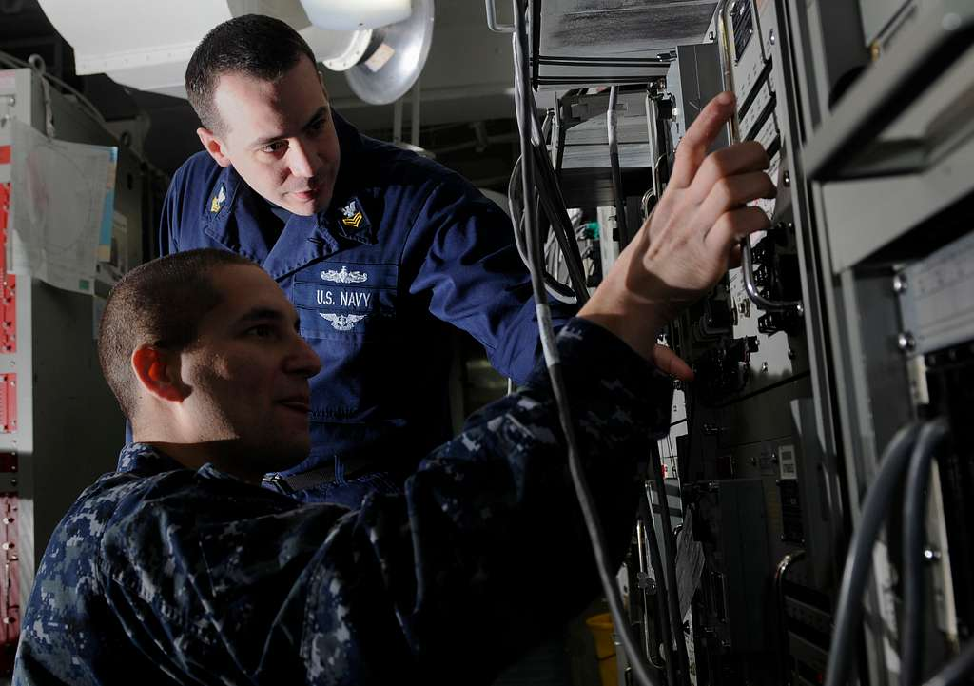
ITADS Information Technology Tutor
Developed with TCS for the U.S. Navy, ITADS provides:
Hands-on sim-based practice: IT troubleshooting and maintenance problems.
Adaptive, automated coaching and feedback as trainees solve problems.
Compared to the control group, ITADS-trained students:
Successfully troubleshooted problems 63% more often.
Finished scenarios 70% faster.
Dept of Defense photo

Slide 14
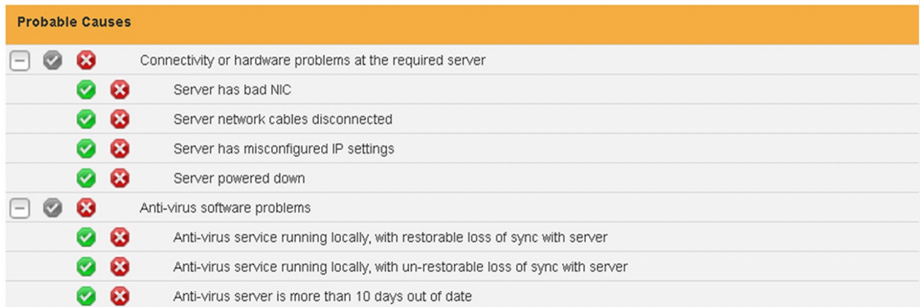
ITADS Teaches Navy’s Troubleshooting Process
ITADS Problem-Solving Exercise Flow
ITADS Interactive Tutor UI – Tracking and Verifying Hypotheses

Slide 15
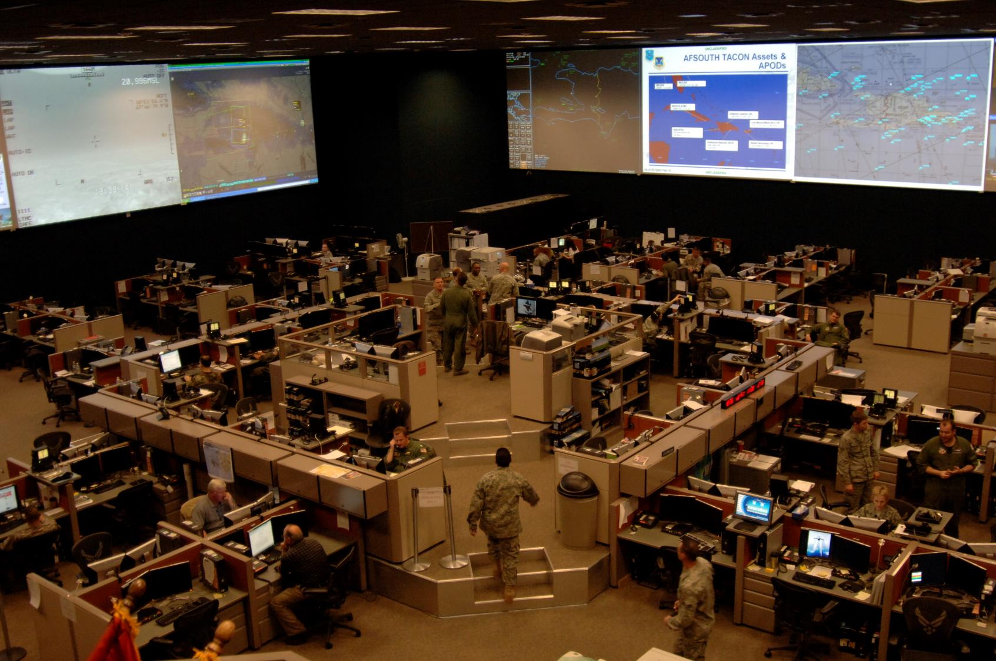
IDA - TBD
IDA Chat Analysis and Visualization for AAR
When high-tempo C2ISR operations use many chat channels for parallel, intertwined discussions, miscommunication is a risk.
Developed for the U.S. Air Force, IDA analyzes and presents chat communications during team training exercises to help instructors review chat data more effectively and lead more productive after-action reviews. IDA:
Associates related chat messages across channels with specific processes and phases of the exercise.
Enables rapid visual review of communications from multiple perspectives.
Dept of Defense photo
Notes:
Photo source: https://media.defense.gov/2011/Jan/14/2000293009/-1/-1/0/100201-F-4972P-301.JPG

Slide 16
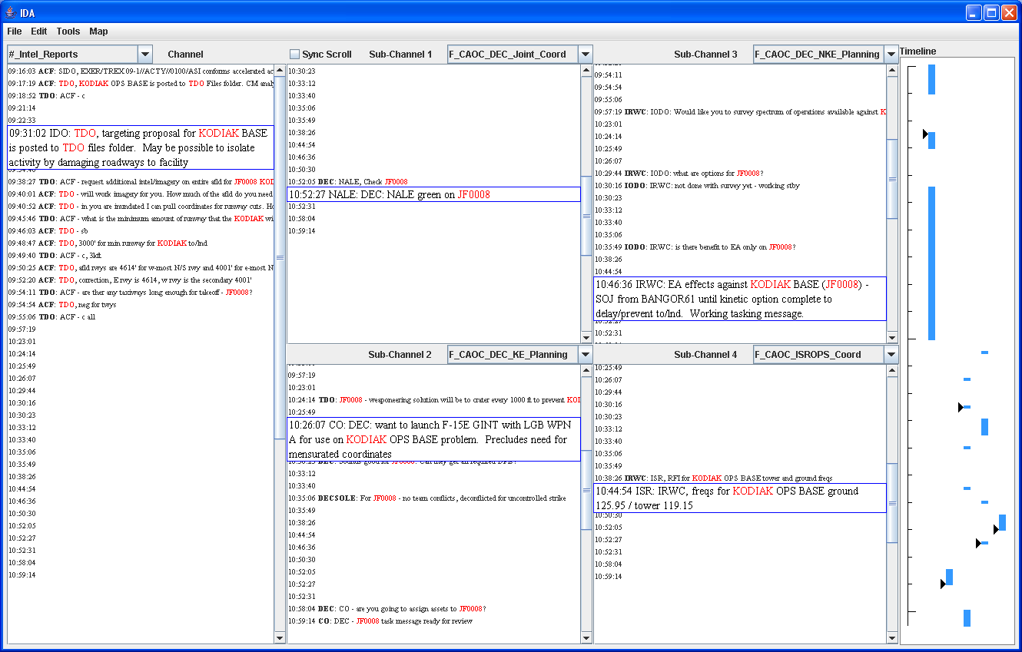
IDA Multi-Channel Chat Browser
Main comm channel of interest
Synchronized scrolling of channels for visualizing information flow
4 supporting channels
Timeline
IDA links related messages within and across channels

Slide 17
AAIRS: After-Action Intelligent Review System for Combined Arms Team Training
4000m
1700m
1000m
400
Final Attack Cones
R&Gs
PGMs
Helps US Marine Corps instructors assess and debrief teams of 100+ exercise force participants.
Analyzes decisions, radio communications, and simulation events to detect, explain, and graphically present AAR debrief training points
Provides playback using 2D, 3D, and timeline displays.
A key part of CACCTUS system which received the Florida Governor’s Award.
Route # 1
IP #2
Route # 2
IP #1

Slide 18
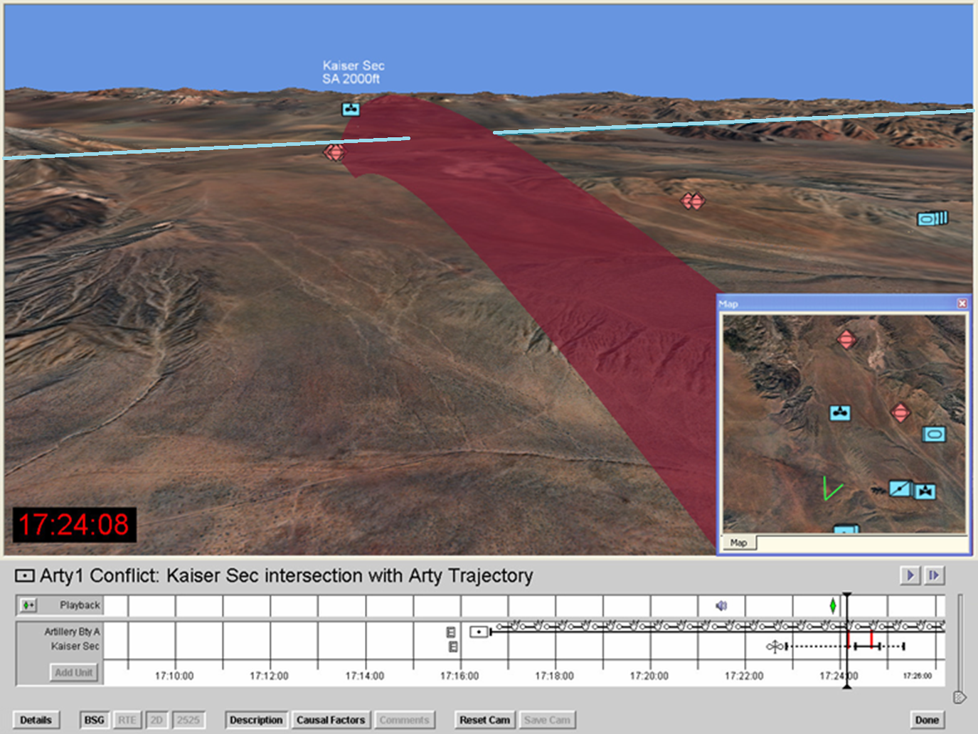
AAIRS Playback via 2D, 3D, Timeline Displays
Fixed wing strike route crossing gun target line
Danger area - active artillery gun target line
Timeline of events related to AAR topic

Slide 19
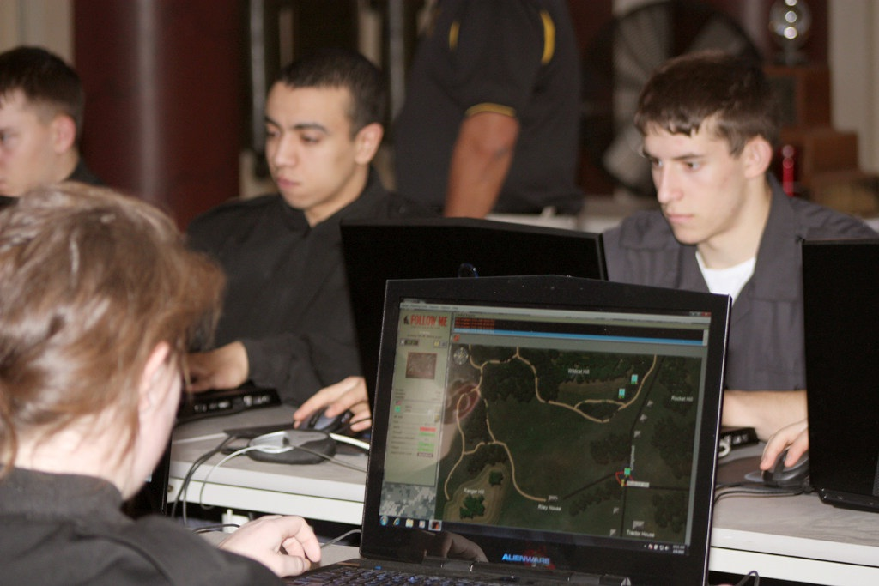
InGEAR:
Intelligent Game-based Evaluation and Review
The Follow Me training game, used at West Point, challenges students to rapidly assess dynamic situations, make sound decisions, and direct subordinate units effectively.
InGEAR is an ITS extension to Follow Me which:
Monitors trainee actions and decisions,
Identifies errors, and
Provides coaching and feedback during and after exercises.
InGEAR enables self-directed learning by providing students with automated, tailored exercise feedback without an instructor.
Dept of Defense photo
Dept of Defense photo

Slide 20
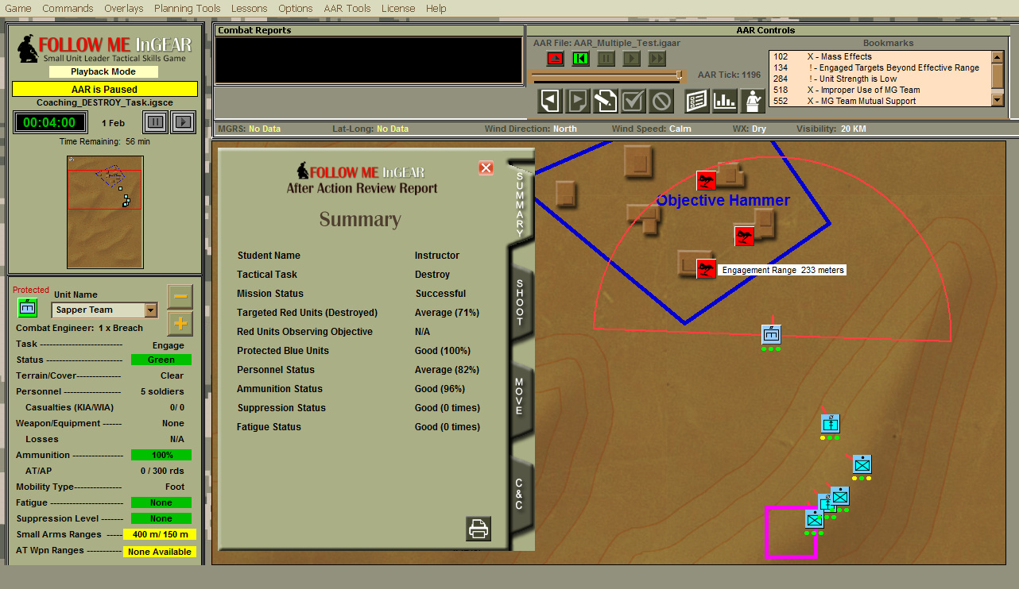
InGEAR:
Intelligent Game-based Evaluation And Review
Dept of Defense photo

Slide 21
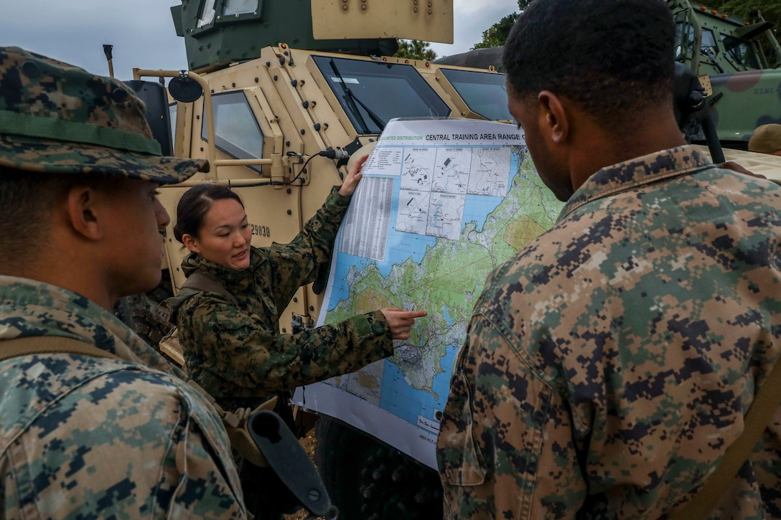
ComMentor
Socratic Tutor for Battlefield Command Reasoning Skills
Improves high-level battlefield command reasoning skills of Army and Marine officers by:
Presenting tactical scenarios,
Evaluating the student’s plans,
Engaging students in a Socratic dialog to discuss the plan, and
Encouraging reflection using hints, questions, and feedback
Dept of Defense photo

Slide 22
ComMentor Student User Interface
Tactical map
Tutor prompt
Student input
Scenario timeline

Slide 23
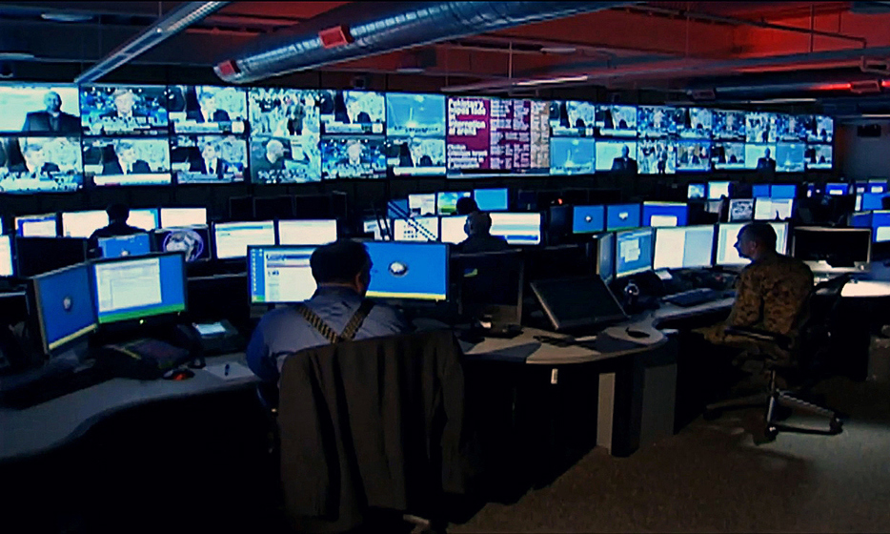
ICT: Intelligence for Counter-Terrorism ITS
ICT helps Army and Air Force intelligence officers identify terrorism threats more effectively.
ICT is an online version of the Army’s “Intelligence for Combating Terrorism” course.
Its constructivist approach encourages learners to develop and apply their own general problem-solving models -- vs. procedures for detecting specific events which might not apply to new enemies and threats.
Dept of Defense photo

Slide 24
ICT: Student User Interface

Slide 25
Intelligent Flight Trainer
IFT provides real-time coaching to help students practice helicopter flight maneuvers.
IFT finite state machines interface with helicopter simulator to:
Track the student’s control inputs, helicopter state, and utterances, and
Provide real-time hints and feedback.
Dept of Defense photo

Slide 26
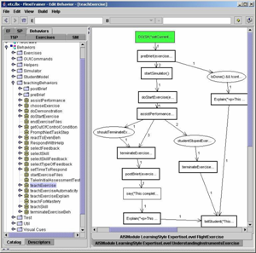
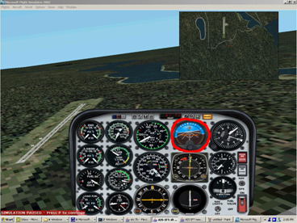
IFT: Real Time Assessment & Coaching
Tutor: You are rolling right. Move cyclic slightly left.
Coaching
Helicopter
control inputs,
State
Exercise selection
Flight Simulator
Real-time Tutor
Assessment and Coaching

Slide 27
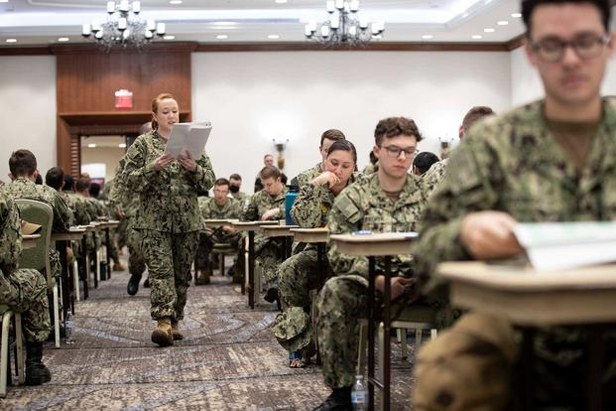
ReadInsight: Reading
Comprehension Tutor
Developed for the U.S. Navy, ReadInsight™ rapidly improves reading skills via:
Precise reading skills assessment, enabling targeted reading, scaffolding, questioning, and remedial exercises for efficient learning,
Probes which enable differential diagnosis among subskills,
Adaptive instruction based on detailed models of each student’s reading skills,
Bayesian reasoning to re-estimate related skills.
Combined with two other learning systems, ReadInsight rapidly improved reading skills by 1.1 grade levels after 36 hours of use. Compared to classroom instruction, ReadInsight improved reading skills in half the time.

Slide 28
ReadInsight Reading Knowledge and Skills Hierarchy
Organization
Summarization
Forward Inference
Global
Comprehension
Knowledge of
Discourse Styles
Identify Main Idea
Local Comprehension
Logical Inference
Causal Inference
Temporal Inference
Knowledge of
Integrative Cues
Construct Referential Representation
Semantic Processing
Co-reference Resolution
Background
Knowledge
Syntactic Processing
Word Identification
Anaphora Resolution

Slide 29
Stottler Henke
Intelligent Training Systems
Authoring Tools
Reduce the Time, Difficulty, and Expense of Developing Intelligent Tutors and Simulation Behaviors

Slide 30
SimBionic
TM
Rapid Development of Real-Time Agents for Intelligent Tutoring and
Simulation Control

Slide 31
SimBionic Overview
Purpose | Simplify and accelerate the development of intelligent simulations and dynamic student performance assessments
Reasoning Methods | Hierarchical transition networks detect and respond to patterns of actions and states. Blackboard communication, polymorphism
Graphical Behavior Editor | Visual IDE enables rapid iterative development and improves collaboration between experts and programmers
Integration | Scalable: small footprint, efficient execution Modular C++ and Java APIs enable integration w/ desktop apps and Web application servers.
Platforms | Behavior editor: Windows Run-time engine: Windows, Linux

Slide 32
SimBionic Behavior Editor
Object Catalog
FSM

Slide 33
SimBionic Applications
Games and Simulations | Enables game/sim designers and developers to develop Intelligent behaviors more quickly and easily.
Performance Assessment and Coaching | Enables instructional developers to implement automated student performance evaluation and feedback within training simulations and other interactive learning systems.
Complex Event Processing | Enables SMEs and analysts to create sophisticated logic for automatically monitoring, filtering, correlating, interpreting event streams for event identification, alerting, and reporting.

Slide 34
TaskGuide
TM
Rapid Authoring of
Step-by-Step Task Support and
Dialog-Based User Interfaces

Slide 35
TaskGuide Overview
Purpose | Simplify the development of software applications that present a step-by-step wizard-like user interface. Each procedure step can accept user data and commands and present information, analysis results, and recommendations.
Sequencing and Scripting | Branching and looping determine the next step, based on user inputs and calculated values. Optional script statements at each step evaluate expressions and call libraries for data, analytics, and systems integration.
Gradual Automation | Manual procedure steps can be enhanced incrementally with scripts to automate data entry, analyses. and decision-making.

Slide 36
TaskGuide: Procedure Guide UI
Procedure Overview pane
Details pane
Execution Log pane
Alerts pane

Slide 37
TaskGuide Applications
Training Tutorials | Present information, pose questions, provide tailored hints and feedback, sequence adaptively.
Debriefing / AAR Systems | Discuss student’s perceptions, decisions, and actions during training exercise to refine assessment, provide feedback, guide reflection.
Performance Support Systems | Guide users through analysis, decision-making, and execution, step-by-step.
Multi-scene Training Scenarios | Such as branching scenarios.
Adaptive Questionnaires | Determine the next question to ask based on previous answers, analyses of those answers, and other data.
Notes:
the operations.

Slide 38
For Additional Information About Intelligent Training Systems
https://stottlerhenke.com/

