Slide 1


An MH-60R success story: how to elevate your training via a modifiable PC-Based simulator for your entire helicopter crew.
DisTec at IT²EC 2023
International Training Technology Exhibition & Conference
Rob Richards, PhD
Stottler Henke Associates, Inc.

Slide 2
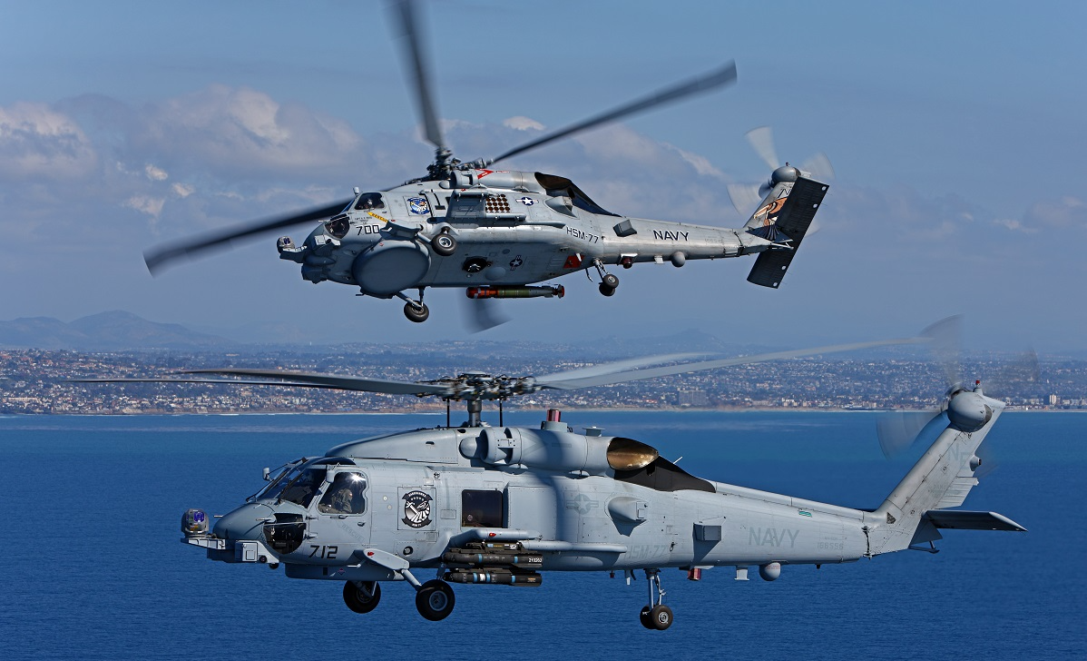

Slide 3
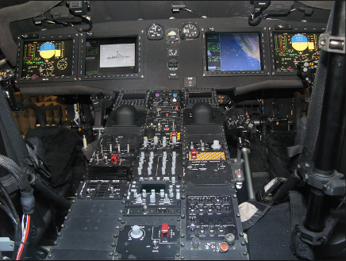
MH-60R COMMON Cockpit

Slide 4
MH-60R Video

Slide 5
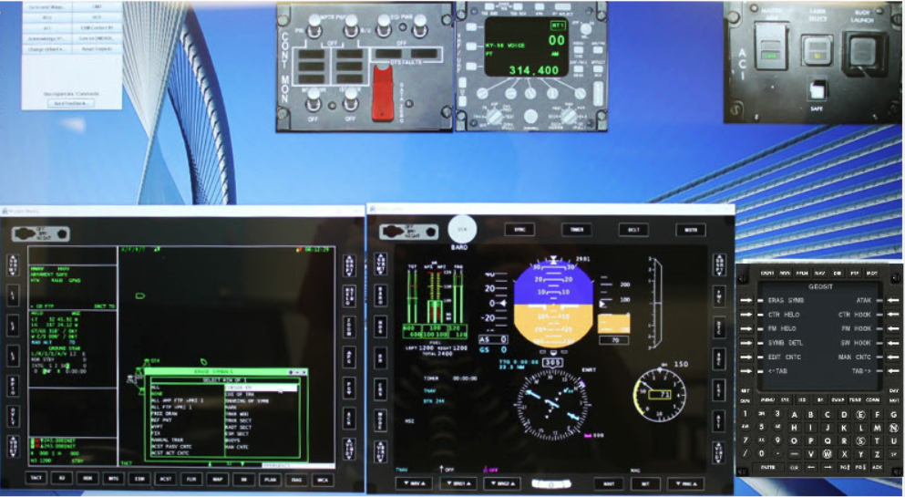
OMIA Emulates MH-60R Helicopters

Slide 6
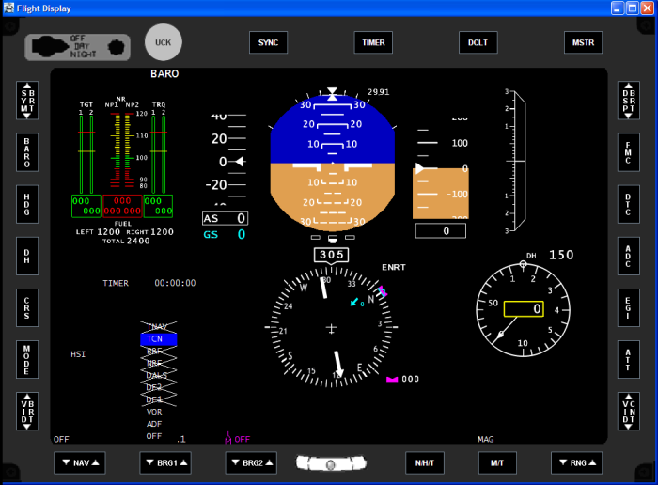
OMIA Flight Display

Slide 7
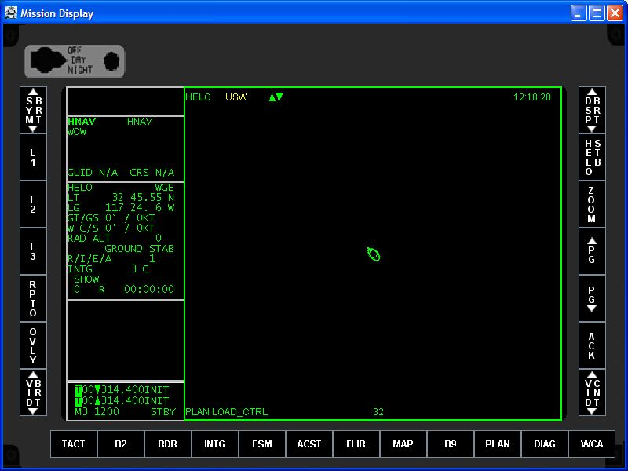
OMIA Mission Display

Slide 8
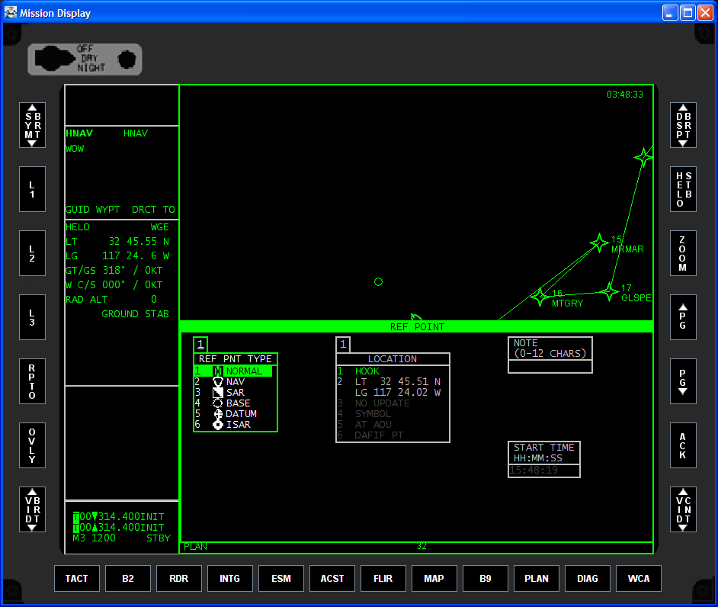
Mission Display with Menu Displayed

Slide 9
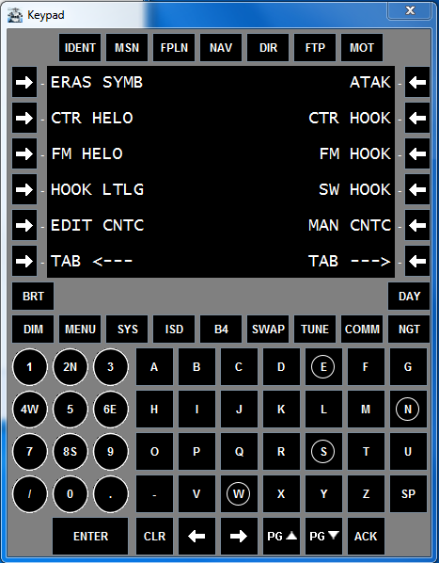
Control Display Unit (CDU)

Slide 10
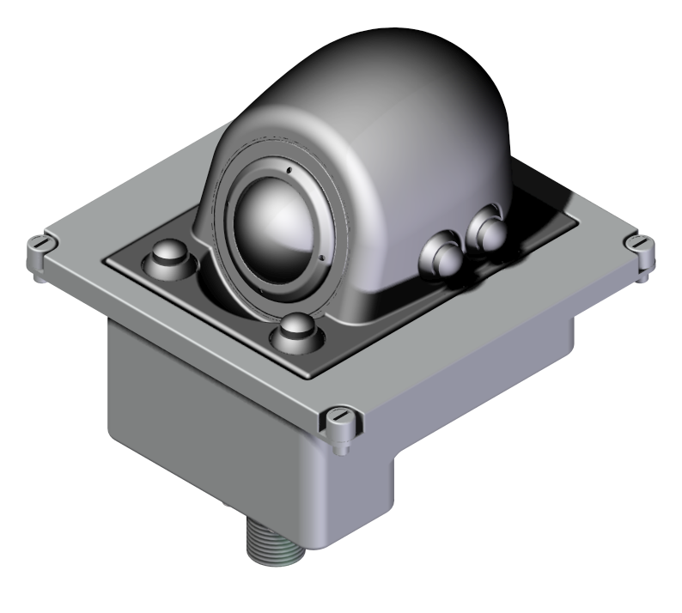
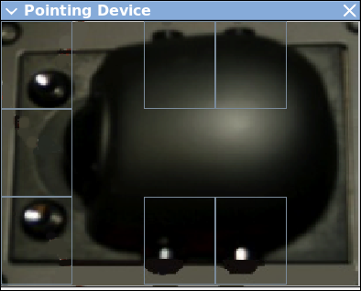
Trackball Pointing device (pd)

Slide 11
MH-60R COMMON Cockpit

Slide 12
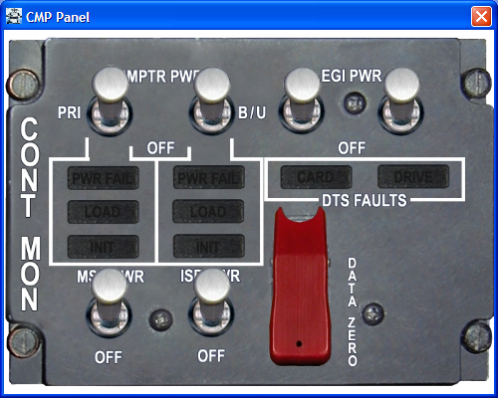
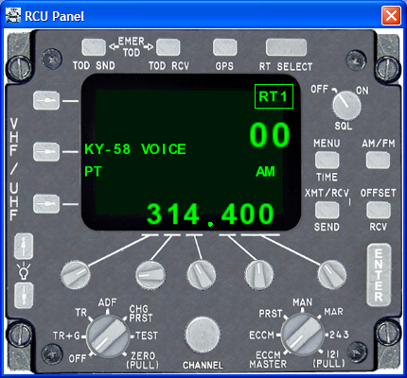
OMIA Emulates MH-60R Panels (E.g., CMP & RCU)

Slide 13
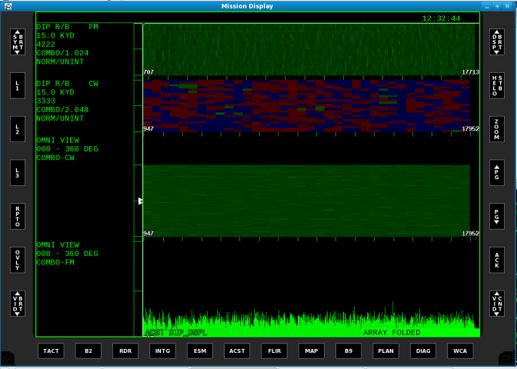
Sensor Operator (SO) Station MH-60R

Slide 14
OMIA Video

Slide 15
SUCCESSES
Reduced overall training costs
  Reduced need for Simulator & Helicopter time
  Significant reduction in training costs
Increased overall effectiveness
  Anytime / anywhere training on land or at SEA
  Leverage via laptop, or cloud, touchscreens, VR, attachable hardware, …

Slide 16
Where OMIA fits
Classroom
Computer Based Training (CBT)
OMIA
Simulators
Helicopter

Slide 17
OMIA User Versions
Romeo Pilot / Co-Pilot
Romeo Sensor Operator
Crew trainer – train Pilot / Co-Pilot & Sensor Operator in same scenario

Slide 18
flexible deployment
Microsoft Windows
Linux
Cloud based
Mac

Slide 19
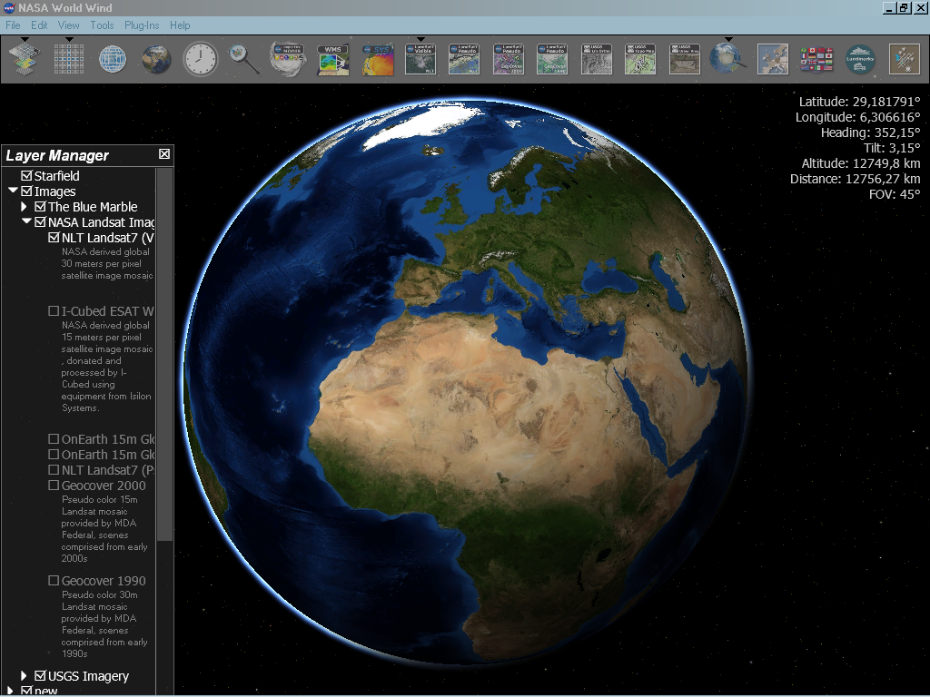
Integrations
USB hardware
Touch screens / VR headset
Acoustics
Flight Simulators
NASA WorldWind for FLIR
& Moving Map

Slide 20
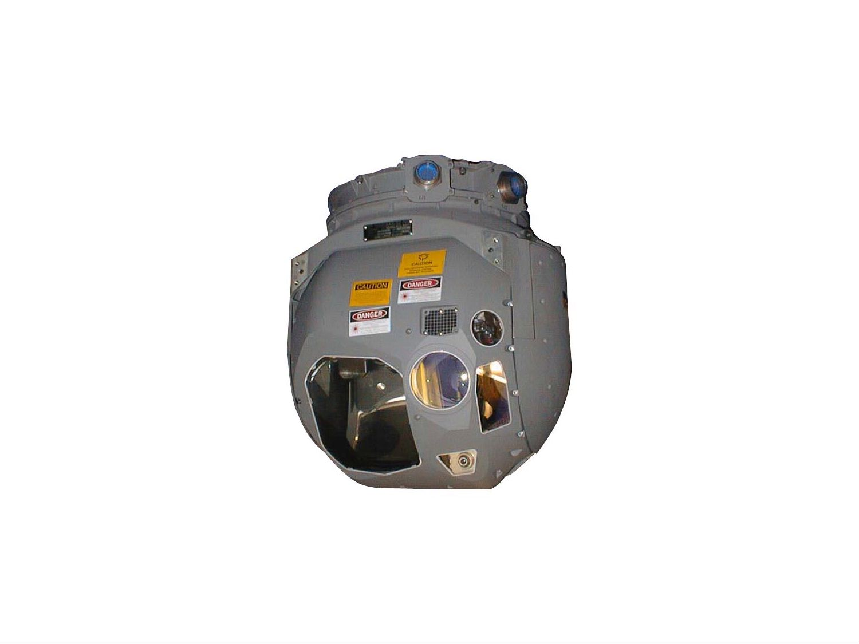
FLIR

Slide 21
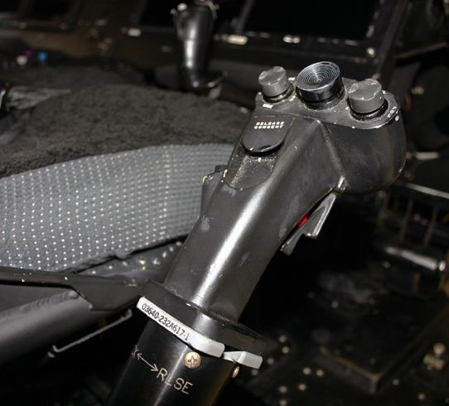
FLIR Hand Control Unit

Slide 22
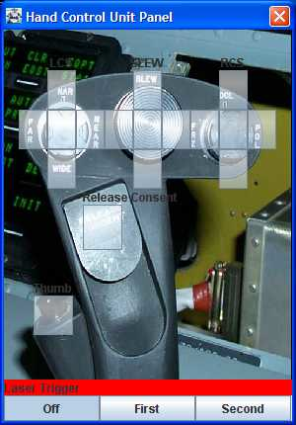
FLIR HCU Software Emulation
Always available, so hardware
HCU is not mandatory

Slide 23
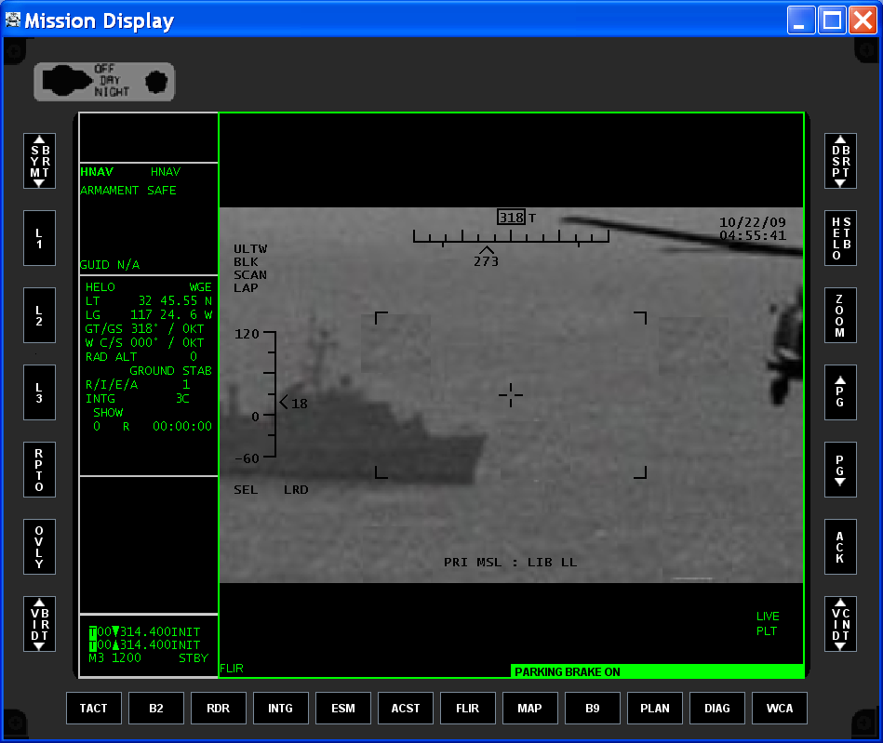
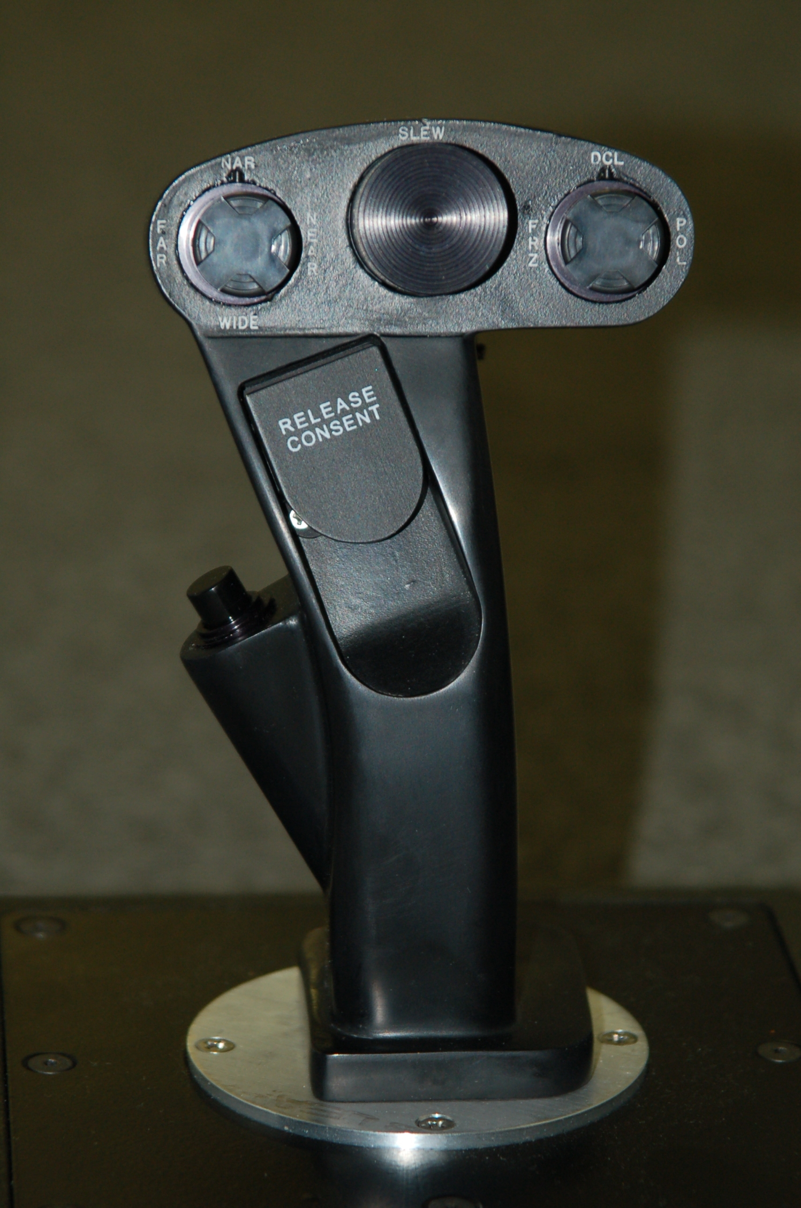
FLIR & USB HCU
Desktop HCU connects via USB

Slide 24
OMIA-ATS / Acoustics
OMIA was enhanced to include Buoy & Airborne Low Frequency (ALFS) Sensor Modeling and Simulation Training.
Allows for pinging and viewing realistic acoustic returns
Enhancement is part of a complete hardware/software solution, including fully configured laptops with touch screen and OMIA-ATS pre-installed.
Leveraged for use on land and while deployed at sea.

Slide 25
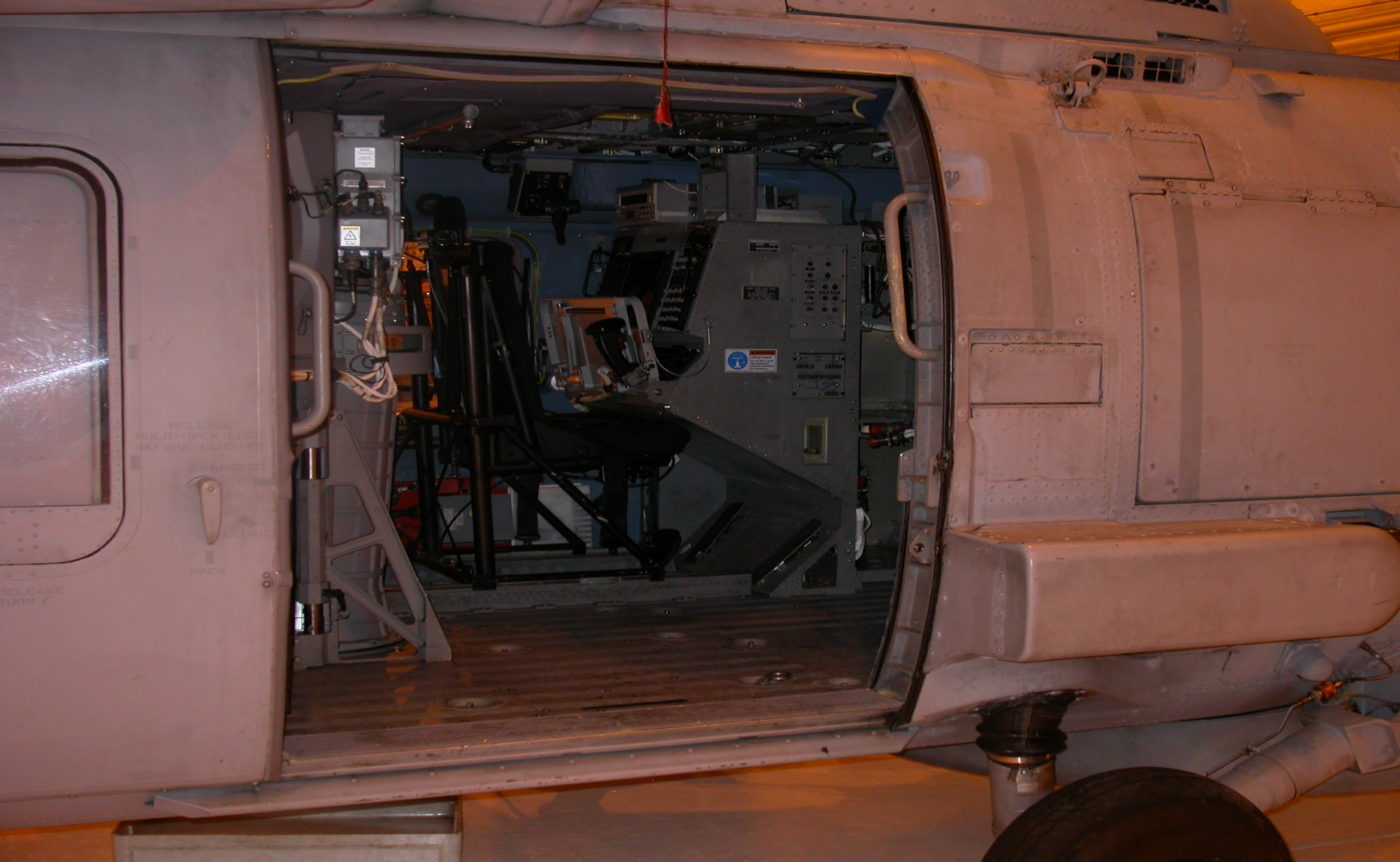
Sensor Operator Station: MH-60R

Slide 26
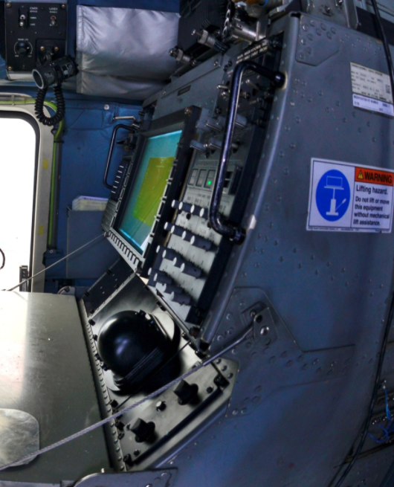
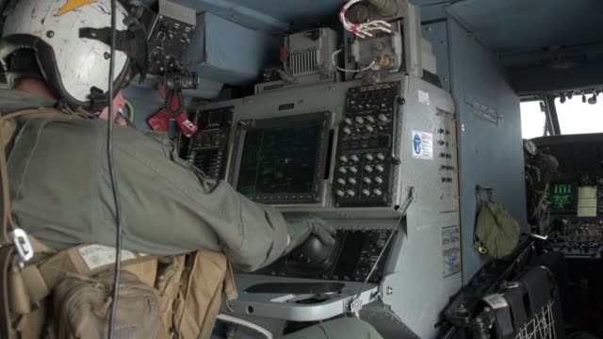

Slide 27
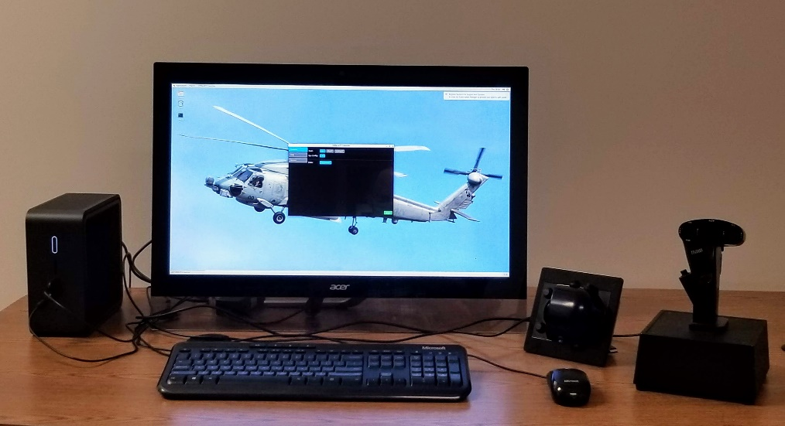
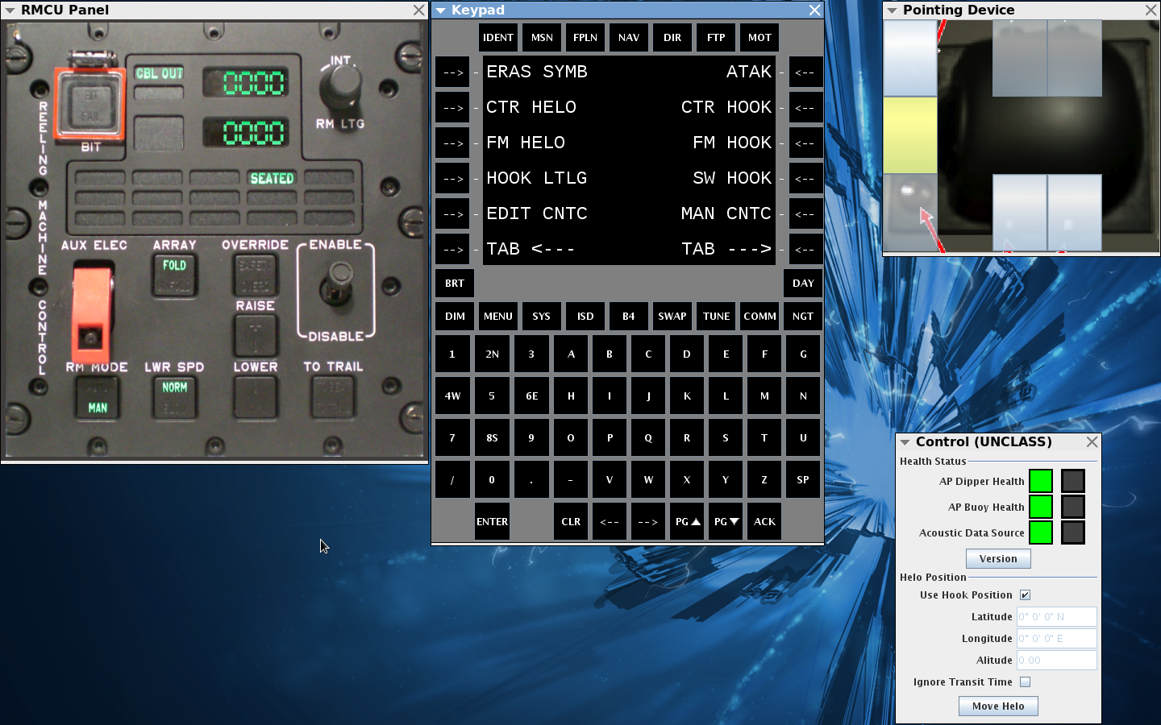
OMIA-ATS: SO station

Slide 28
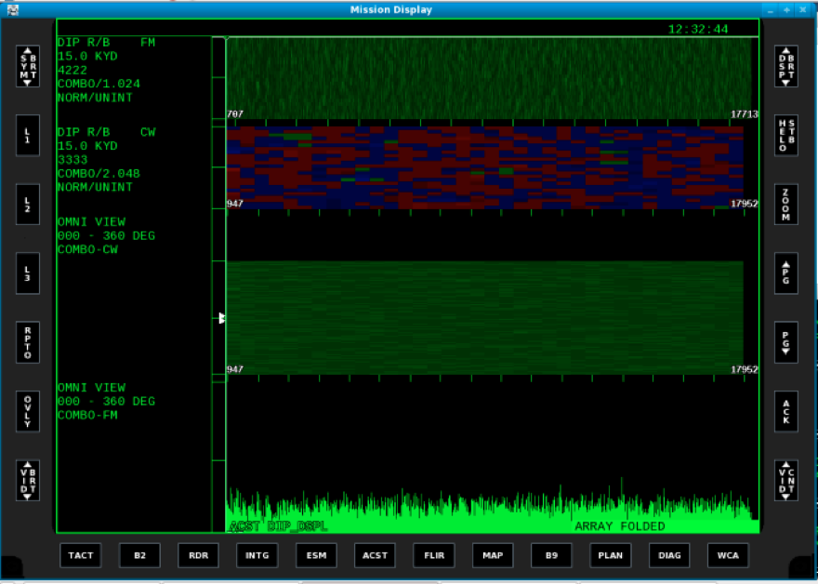
OMIA-ATS: SO station
4 Modes of OMIA-ATS:
Simulated Noise Mode
Create Scenario Mode
Play Scenario Mode
Analyze Data Mode

Slide 29
BENEFITS of OMIA-ATS
Prepare operator to take full advantage of TOFT training sessions
Provide a platform for acoustic return recognition training
Support independent skills review for deployed squadron personnel
Support independent skills review in a Training facility environment

Slide 30
OMIA / OMIA-ATS
Summary
Powerful inexpensive anywhere / anytime training
Capabilities maximized based on available hardware
Cost savings vs simulator/flight time
Training Benefits of Re-configurable Part-Task Trainer (PTT)
  OS agnostic
More information on OMIA is available at
www.StottlerHenke.com/OMIA

Slide 31

QUESTIONS ?

