Slide 1
Critical Chain Project Management: An Introduction
Rob Richards, Ph.D.
Project Manager
Stottler Henke Associates, Inc.
Notes:
Welcome
My name is Rob Richards
I am a project manager at Stottler Henke Associates
where I assisted in the design of our critical chain software, Aurora-CCPM.
This presentation provides an introduction to critical chain Project management,
and assumes only a basic understanding of project management principles.

Slide 2
Presentation Outline
Motivation & Background
Problem [What to Change]
Localized Risk Management
Task Level Insurance Policy
Student Syndrome
Parkinson’s Law
Solution [What to Change to]
Global Risk Management
Project Level Protection
Systems Perspective
Execution Control
Notes:
This presentation is divided into three major sections.
The 1st is
motivation and background
what is the motivation for looking for a different way of performing project management, and
some background on project management theory and practice.
The 2nd is
The problem
that is, what needs to be changed.
The 3rd is
the solution
That is, what to change to.

Slide 3
Motivation
< 45% of all projects finish on schedule or before
< 17% software projects completed on-time / on-budget.
IT related projects
23%+ of projects will be canceled before they ever get completed. Further results indicate
50%+ of projects cost > 150% original estimates
Ref: www.it-cortex.com/Stat_Failure_Rate.htm www.pqa.net/ProdServices/ccpm/W05002001.html
Notes:
Motivation for developing a new paradigm for project management
Projects Have Been known to be Late
Here are a few widely quoted statistics about projects success
Whatever the true situation may be, almost all who deal with projects and almost all studies indicate there is much need for improvement

Slide 4
Results: Switching to Critical Chain
Lucent Technologies
Outside Plant Fiber Optic Cable Business Unit reduced its product introduction interval by 50%, improved on-time delivery, and increased the organization's capacity to develop products.
Seagate
Brings 1st 15,000 rpm disc drive to market ahead of its competition, causing all competition to pull out of the market. (circa 2000).
Lord Corporation (high-end auto & aerospace OEM)
Capacity has increased, cycle time improved, and operating expense remained the same.
Notes:
Therefore, there is plenty of incentive to find a better method
This slide shows just a few success stories for those who have switched to critical chain
The slide presents a sampling of results for
Lucent Technologies
Seagate, and
Lord Corporation
there are many other success stories,
However this sampling demonstrates what can be considered typical improvements experienced by companies that have implemented critical chain

Slide 5
Are You a Responsible Person?
asking for one:
When asked for task estimate or
What do you supply?
How often is the "Three Point Estimation” used?
How do you work when assigned to a task?
What do you assume is supplied?
Activity
Start
Completion
Activity
Start
Completion
Notes:
are you a responsible person when dealing with task duration estimates?
what do you supply when you’re asked for a task estimate?
what do you assume is supplied to you when you ask someone else for task estimate?
is only one number provided or given as a task estimate?
Are probabilities normally supplied or given regarding task estimates?
Is the three point estimation technique utilized?
another important question is, how do you work once the task has started
* Does work occur on the task as non-stop as possible, so the level of activity is relatively constant?
Or is this task often interrupted so that there are many intervals when the task is not being worked on?
or is there in initial burst of activity at the beginning of the task, and then due to interruptions or other factors, the task is largely neglected until some deadline trigger forces one to return to the task?
These points will be further addressed later in the presentation.

Slide 6
Three-point Estimation of Task Times
In three-point estimation, three figures are per task, based on prior experience
or best guesses
a = the best-case estimate
m = the most likely estimate
b = the worst-case estimate
Do most projects ask for these three?
Which of the estimates is closest to the estimate most people report when asked?
Most Likely
Likeliness
PERT
Beta distribution
Opt.
Pess.
5
10
15
20
25
Hours
UNCERTAINTY
Notes:
Let us review the three-point estimation of task durations,
as well as the general distribution of task durations during execution.
First let’s look at the curve for describing how long tasks may actually take. Starting with the most optimistic estimate, there is a certain amount of effort, and therefore time,
that must occur to complete a task,
so the most optimistic estimate is the duration if everything went perfectly and there were no interruptions, in the illustration this is 10 hours.
The shape of the curve is due to the fact that there are any number of reasons that a task can go long,
so if the pessimistic estimate was even greater than the 25 hours shown in this illustration
the tail of this distribution would be even longer.
By providing the three estimates, optimistic, most likely and pessimistic an overall curve can be established, and a PERT duration for the task can be calculated.
Critical chain does not use the PERT estimate so the details of the calculation will not be described further here.
This diagram illustrates the risk in asking for one estimate without clarifying what is being asked for, for example, if the recipient of the information assumed that the estimate was the pessimistic estimate, while the provider of the estimate assumed it was the most likely estimate, it is obvious that this would cause problems.

Slide 7
Presentation Outline
Motivation & Background
Problem [What to Change]
Localized Risk Management
Task Level Insurance Policy
Student Syndrome
Parkinson’s Law
Solution [What to Change to]
Global Risk Management
Project Level Protection
Systems Perspective
Execution Control
Notes:
now we will address
The problem
that is, what needs to be changed.

Slide 8
Problem: Localized Risk Management
Task level insurance policy
** How safe is safe enough?**
Student Syndrome
Parkinson's Law
Self-fulfilling prophecy [good estimating?]
Multi-tasking [absence of priorities]
50% confidence
10%
confidence
completing
90% confidence
Start
Notes:
a major source of problems is
localized risk management
and subsequent problems that occur due to localized risk management
What is meant by localized risk management is,
it is assumed that for the project to finish on time, each of the tasks need to have a high probability of finishing on time
So returning to the issue of task estimates, how safe is safe enough for individual task?
In standard project management, each task needs to finish on time so therefore the task duration needs to be estimated where there is a high confidence of this occurring, so the estimates are biased towards the 90% confidence level, then as we have seen previously this can be much longer than the 50% confidence task estimate.
Unfortunately, by allowing for these quote safe estimates unquote many bad habits are promoted, which in many cases result in the task taking longer than even the safe estimate.
The student syndrome describes the situation where a student does not work on a task initially because they have been allotted much more time than is actually needed to complete the task, however, they do not use the time wisely and finally the impending deadline triggers them to concentrate on the task, but in many cases the actual effort was more than foreseen resulting in the task being completed late.
Another issue is Parkinson’s Law, that states that all tasks will expand to fill the time allocated to them, so even if the task was worked on diligently and may be a essentially complete, there is always a way to improve the result, so the task is never submitted early.
Also, since there is safety built into the task there is much more incentive to multitask.

Slide 9
Multi-tasking
One Resource, Four Tasks, from Four Different Projects
Multi-tasking / task switching has overhead causing more delays to spread across all projects.
Notes:
Here we examine the effects of multitasking with a simple example of four projects.
In this example there is one resource that needs to complete 4 tasks, each related to a different project
Notice the difference in end times between the non-multitasking approach to task execution, and the multitasking approach to task execution.
who benefits from the multitasking approach? Project one does not benefit, the yellow task finishes much later,
project two does not benefit, it also finishes much later, project three but not benefit, it finishes later
finally project 4 theoretically finishes when it otherwise would.
so by multitasking much on time performance has been destroyed without any benefit.
Unfortunately, Task switching has overhead, so the multitasking results would be even worse than those illustrated here

Slide 10
Presentation Outline
Background
Problem [What to Change]
Localized Risk Management
Task Level Insurance Policy
Student Syndrome
Parkinson’s Law
Solution [What to Change to]
Global Risk Management
Project Level Protection
Systems Perspective
Execution Control
Notes:
Now we move on to the solution

Slide 11
Solution
Governing Principle Behind Critical Chain is:
Aggregation of risk…
Benefits:
Lower overall protection needed
Higher degree of “coverage” achieved
Leading to lower incidence of “failure”
Notes:
We have seen that localize risk management causes many problems
fortunately the principle of aggregation of risk can help solve many of these problems.
Aggregation of risk is the governing principle behind critical chain
Benefits of aggregating risk include:
a lower amount of protection is needed
while a higher degree of protection can be achieved
which results in improved project performance

Slide 12
Solution
Planning
Project Level vs. Task Level Protection
Systems Perspective for Multiple Projects
Pipeline projects with overlapping resources
Execution Control
Promote and encourage team culture
Controlled work queues
No multi-tasking work rules
Task assignment prioritization
Management by Exception
Notes:
aggregating risk is a more global approach to risk management
that is during project planning the goal is to protect the project at the project level and not necessarily at the task level
these concepts can be extended to multiproject implementations, which will result in maximizing throughput
during execution this global approach to risk management will actually promote and encourage a team culture. Some of the ways that this will occur is via controlling the total amount of work in process, no multitasking work rules, task assignment prioritization so that tasks most important to the overall project are worked on in the correct order; and finally management by exception; which means allowing tasks and people working on those tasks to be left alone if sufficient progress is being made, and providing help in a nonjudgmental way to those tasks that are running long for what ever reason.

Slide 13
Critical Chain Planning Process
From Task to Project Protection
1. Traditional Plan
144 hours
2. Safety Excluded
72 hours
3. Resource Leveled
4. Critical Chain Marked
84 hours
Notes:
here we will examine how the aggregation of risk principle actually plays out in the critical chain planning process.
we start with a traditional critical path plan
in these diagrams Each color represents a different skill category, and there is quantity one of each skill category.
the first step in the process is to exclude the built-in safety of all the task estimates, a simple rule of thumb is to simply cut the current task durations in half
after the safety has been excluded resource leveling is applied to eliminate any resource conflicts
so in this illustration no same colored tasks should occur at the same time
finally the critical chain is marked
The critical chain is the sequence of both precedence- and resource-dependent tasks that prevents the project from being completed in a shorter time, given finite resources.
This is the same as the resource-constrained critical path when using aggressive durations

Slide 14
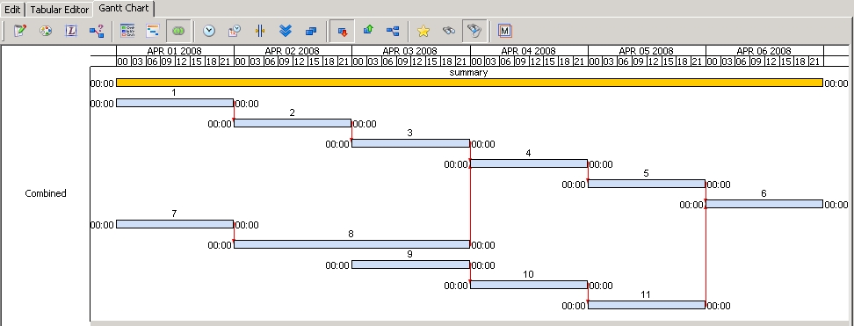
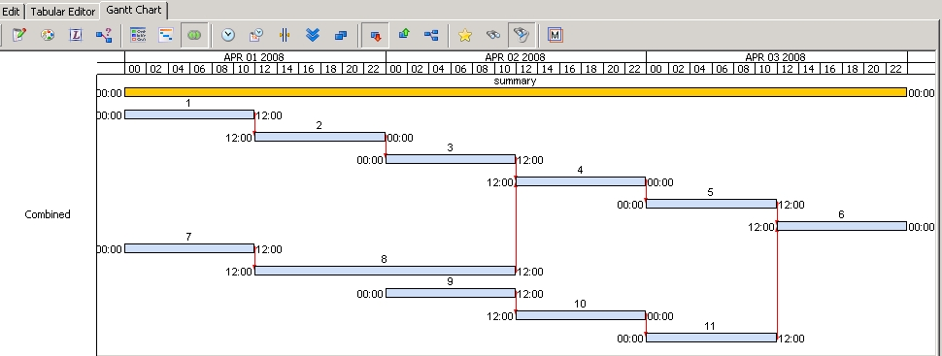
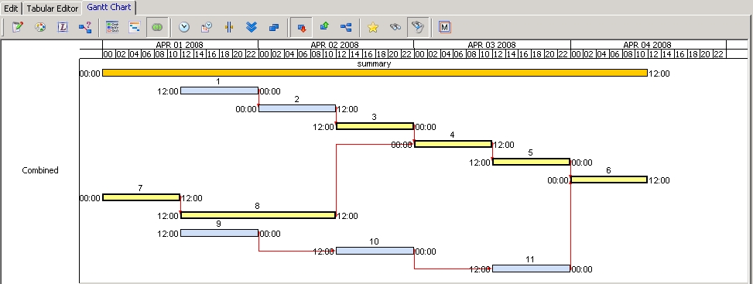
Critical Chain Planning Process: Gantt
From Task to
Project Protection
144 Hours
1. Traditional Plan
72 Hours
2. Safety Excluded
3. Resource Leveled
4. Critical Chain Marked in Yellow
84 Hours
Notes:
This slide simply shows the same process in a Gantt chart with technical links shown in red and critical chain elements in yellow.

Slide 15
Aggregation Principle
The Concept of Risk Pooling:
Health Care Insurance Example:
Larger pool = Lower cost
Notes:
Because the aggregation principle is so important to the success of Critical Chain, let’s return to it.
The concept is the same as Risk Pooling
Most people are familiar with the health care insurance situation, where the larger the pool the lower the cost of the premium.
The total cost to all participants should be close to the total cost of the health care cost for the participants.
Each participant no longer needs to save enough money to be able to pay for all their
potential
health care needs

Slide 16
Aggregation Principle (2)
Insurance is designed to work by spreading costs across a large number of people. Premiums are based on the average costs for the people in an insured group. This risk-spreading function helps make insurance reasonably affordable for most people.
http://www.insurance.wa.gov/legislative/factsheets/PoolingRiskReducingCost.asp
Notes:
The risk spreading of insurance makes it more affordable.
Similarly, by pooling the risk over the entire project makes fully protecting each task unnecessary and the sum of the protection needed is less.

Slide 17
Critical Chain Planning
Compared to 144 hours traditional
132 hours
PB = Project Buffer FB = Feeding Buffer
Aggregation Principle [where did some of the safety go?]:
Pooled protection provides more coverage
Location is just as important as amount
Sizing Rule of Thumb → Buffer is ½ of preceding chain
Notes:
By applying the Aggregation Principle, the amount of protection required in a schedule decreases as the number of tasks being protected increases.
A series of tasks protected at one location requires less protection than if each task was to be individually protected.
The Location of the protection is just as important as the amount
So buffers of protection are strategically located in the project plan, with a large project buffer at the end of the project.

Slide 18
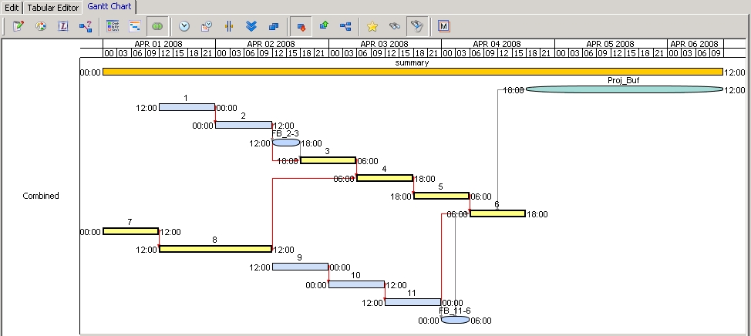
Critical Chain Planning
Schedule shown in Aurora
132 hours compared to 144 hours in traditional schedule
Proj_Buf = Project Buffer FB = Feeding Buffer
Notes:
Here is the Gantt chart representation of the Critical Chain Network
Critical Chain elements are in yellow.
Buffers are elliptical in shape.

Slide 19
Critical Chain in Execution
Schedule Before Execution Starts
Notes:
Now we move on to how Critical Chain operates in execution. We expect things to NOT go as planned.

Slide 20
Critical Chain in Execution
Schedule Before Execution Starts
“AS OF DATE”
T1 & T7 finish on time
Notes:
As the project progress, both tasks T1 and T7 essentially finish on time

Slide 21
Critical Chain in Execution
Schedule Before Execution Starts
“AS OF DATE”
T8 experiences increase in Scope or Delay
First portion of delay absorbed by gap between T3 & T4
= Original T8 duration
Notes:
After task T8 has been worked on for a time,
an update is provided that estimates the remaining duration,
and this shows an end time of task T8 which is later than the original aggressive estimate.
In this case the delay is absorbed by the gap that existed between T3 and T4.

Slide 22
Critical Chain in Execution
Schedule Before Execution Starts
“AS OF DATE”
T9
T10
T11
FB
132 hours
Rest of delay impacts the project buffer
T11 also affected due to resource constraint
E.g., So as of the “As of Date” project may be → 7% Complete with
30% Buffer Consumed
= Original T8 duration
= project buffer impact
Notes:
When the next update is received,
the estimated end date for T8 is even later,
this delay effects the rest of the project and impacts the project buffer.
Note how task T11 is also effected,
due to the fact that it uses the same resource as tasks T8 & T3,
so T11 will not get access to this resource until T3 is done with it.
But since T6, which is the integration point, is also moved right, there is currently no Feeder buffer impact.

Slide 23
Critical Chain in Execution
Schedule Before Execution Starts
“AS OF DATE”
T10
T11
T9
FB
T1 & T7 finished on time
T8 experienced increase in Scope or Delay
First portion of delay absorbed by gap between T3 & T4
Rest of delay impacted the project buffer
T11 also affected due to resource constraint
E.g., So as of the “As of Date” project may be → 7% Complete with 30% Buffer Consumed
= Original T8 duration
= time absorbed by project buffer
Notes:
Let us review
T1 & T7 finished on time
T8’s duration was longer than its planned aggressive duration
First portion of T8’s delay, absorbed by gap between T3 & T4
Rest of delay impacted the project buffer
T11 also affected due to resource constraint
Current project status: 7% complete with 30% buffer consumed
Note many complicated interactions can be occurring, but as will be elaborated, the project manager just needs to monitor buffer impacts, which is much simpler.

Slide 24
Perspectives on Buffers
Not “rear view mirror watching”
Predictive/Preventative/Leading Indicator
Mechanism to Promote and encourage Team Work
Collaboration / Communication Incentive Mechanism
Measuring device – Neutral, Normalized Metrics
Real-time Risk Meter
Encourages a holistic/goal oriented perspective
Notes:
Here are some perspectives on Buffers,
note that they are
Predictive Leading Indicators
That
Promote and encourage Team Work
Psychology and sociology teaches that.
Human Behavior is greatly affected by the context / ENVIRONMENT the human is in
This is not always obvious because people are actually very good at controlling their context.
Project management teach how team members should perform and how project managers should deal with human relationships to make projects successful.
HOWEVER, most of the time we are trying to change human behavior withOUT changing the environment.
* Critical PATH project management creates a ENVIRONMENT for people to perform in
* Critical CHAIN project management creates a very different ENVIRONMENT for people to perform in
* Critical Chain is a environment that promotes the type of behaviors that are needed for effective teams
For example, “Avoid Blaming & Complaining”
* Critical Chain → When things go bad → team rushes to help NOT blame
So incentive to hide problems & look for scapegoats is greatly reduced.

Slide 25
Critical Chain Priority Metric
Project Status Trend Chart or “Fever” Chart
Notes:
Critical Chain simplifies
the complex interactions and effects of tasks durations differing from the aggressive estimates during execution,
via the Fever Chart.
The Fever Chart plots the % Project Buffer Consumed against the % of the total critical chain completed.
The chart, shown here, shows the project near its completion, each corner shows were an update was provided.

Slide 26
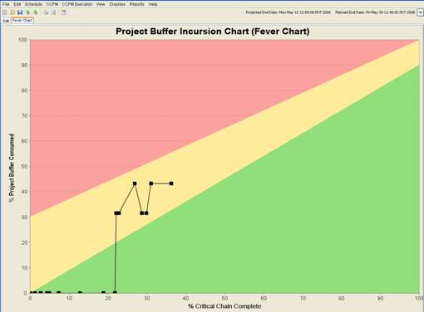
Project Status: Fever Chart
Notes:
This example of a Fever Chart provides a snapshot earlier in a project.
Each filled in box represents where a project update occurred.
In this case, the initial critical chain tasks were completed ahead of their aggressive durations on average.
Then some later task experienced delay that caused some project buffer penetration.
Since the overall buffer penetration is in the yellow, the overall project is in good shape and no intervention may be needed.
The other indicator that helps the Project Manager is the TREND of the chart, when the trend is more vertical, it may be a cause for concern.
So in this case, even though the chart jumped ONLY into the yellow, the rate that the buffer consumption occurred would warrant further investigation.

Slide 27
Results (2)
Harris Corporation:
Construction of its $250 million wafer fabrication plant – 3 days ahead of 13 month schedule (original plan was for 18 months & 4% over budget at the start of the project).
Balfour Beatty
Civil engineering projects ahead of schedule and under budget.
FMC Energy Systems
Sub sea systems on-time performance went from < 50% to >90%.
Notes:
Now that we have looked at the workings of Critical Chain project management.
Let’s pause and take a look at a few more of the many success stories.

Slide 28
Multi-Project Critical Chain
Systems Perspective for Multiple Projects
Should load for multiple projects be considered jointly?
Obviously
Why?
Prevent System Overload/Multi-tasking
How?
By taking a Systems Perspective
Notes:
For a multi-project environment, we want to make sure the benefits of critical chain are retained.
This is done by pipelining the projects to avoid bad multi-tasking

Slide 29
Creating a Multi-Project Schedule
Finite Capacity Pipeline
Due Dates Are Derived
Ingredients:
CC Plans [shorter]
Strategic Pacing Mechanism
Strict Priority Scheme
Rate Limit Policy/Guidelines
Notes:
There is only so much capacity to do work, we will refer to this as the finite capacity pipeline.
Projects are allowed to start ONLY if there is enough capacity to prevent multi-tasking
Due dates are DERIVED by the pipeline, NOT by promises
NOTE the down pointing arrows near the top are the derived delivery dates

Slide 30
Multi-Project Execution Control Pipeline Status Snap Shot
1003
1002
1001
1007
By Portfolio of
Projects
0 % Buffer Consumed 100
1006
1004
1009
In Execution, Buffer Status Drives Priority Decisions, not Project Importance
1005
1008
1010
| | | | | | | | | | | | | | | | | | | | | | | | | | | | | | | | | | | | | | |
0
% Critical Chain Completed
100
Notes:
The multi-project Fever chart allows executive management and others to see the status of a portfolio of projects.
Each dot in this fever chart shows the current status of an individual project
IF more detail is desired for a particular project, one can drill down to the particular project’s fever chart to see its history
So Buffer Status drives priority decisions,
Therefore in this figure project
1003
Would be the highest priority project

Slide 31
Overall Benefits & Challenges
Benefits
Operational Coherence – Stability
20% Shorter Cycle-Times – Speed
On-time Performance – Reliability
More throughput – Growth
Challenges:
1. Simple but not easy to grasp – too simple?
Requires a change in mindset
Takes 120 days for typical 100 person team
We don’t need that much improvement
Notes:
Challenges encountered when trying to introduce critical chain to an organization
Include
The difficulty in changing people’s mindset, for example, regarding multi-tasking
And the delay in getting improved results can lead to people giving up on the conversion pre-maturely.
Fortunately, the Benefits that have been experienced include improved project
Stability, Speed, Reliability & business Growth

Slide 32
GRACIAS POR SU ATENCIÓN
Rob Richards, Ph.D.
Project Manager
Stottler Henke Associates, Inc.
Richards@Stottlerhenke.com
Notes:
Welcome
My name is Rob Richards
I am a project manager at Stottler Henke Associates
where I assisted in the design of our critical chain software, Aurora-CCPM.
This presentation provides an introduction to critical chain Project management,
and assumes only a basic understanding of project management principles.

