Slide 1
So you want to field your intelligent planning and scheduling system?
Then suck it up!
ICAPS-UISP 2017
June, 2017
Dick Stottler
Stottler Henke Associates, Inc.
Notes:
Ask The Question
Mention we’ve done dozens and dozens over 30 years and the same issues keep popping up

Slide 2
Overview
Background
Principles of UI Design for Acceptance and Fielding of IP&S Systems
Details for each principle
Examples for each principle
Some notes about future UI options
Summary

Slide 3
Background
(Mostly obvious, but just in case …)
Every domain/client/end-users are different
  Vocab/concepts/algorithms/technical sophistication => UI
Many domains are only semi-modeled
  Both on-purpose (avoid eye-rolls) and because of errors
User (Interface) efficiency / Good UI design is important
Real World UI Design Heuristics
Existing Work Flow/ConOps/Bureaucracy
The user will sense and perceive your IP&S system entirely through its user interface
“You can not automate me!” - Tom Overton, NASA KSC Mission Planning Office, 1990. Lots of initial skepticism!

Slide 4
UI Design Principles for IP&S System Acceptance (Decreasing Frequency/Importance)
General Good UI Design Principles
Explanations/Trust (see quote above)
Go with the (work) flow
Flexibility/Robust UI
User Acceptance Requirements (See title above)
Legacy System Integration
Different domains = Different Conflict concepts
User editing “final” product / replanning
Special UI Challenges with truly distributed / mixed initiative planning and scheduling

Slide 5
General Good UI Design Principles
Use clients Vocab/Concepts/Symbology/Look/Reports
  Quick understanding
  Semi-Modeled domain (both on-purpose and errors)
Resource versus time (individual and pooled resources)
Task Analysis/Cog. Task Analysis: What need to do, What Decisions, What information needed for those decisions, Info. on screen, minimize mouse clicks
  Real users are often very sensitive to UI Efficiency!
Existing system – what do they like and hate about the UI?
See the actual work environment, response time frame
How long it’s going to take / Progress bars / How automatic you make it
Talk to users at beginning and throughout, bounce story boards off them and preliminary versions.
Notes:
Activity / task / job / project /flow / support / collection/…
Quick Understanding To find “mistakes”
Pert / Gantt everyone knows about
But resource versus time is always used in almost every domain
[E.G. Aurora had a separate dedicated project for its UI to make it flexible and easily customized

Slide 6
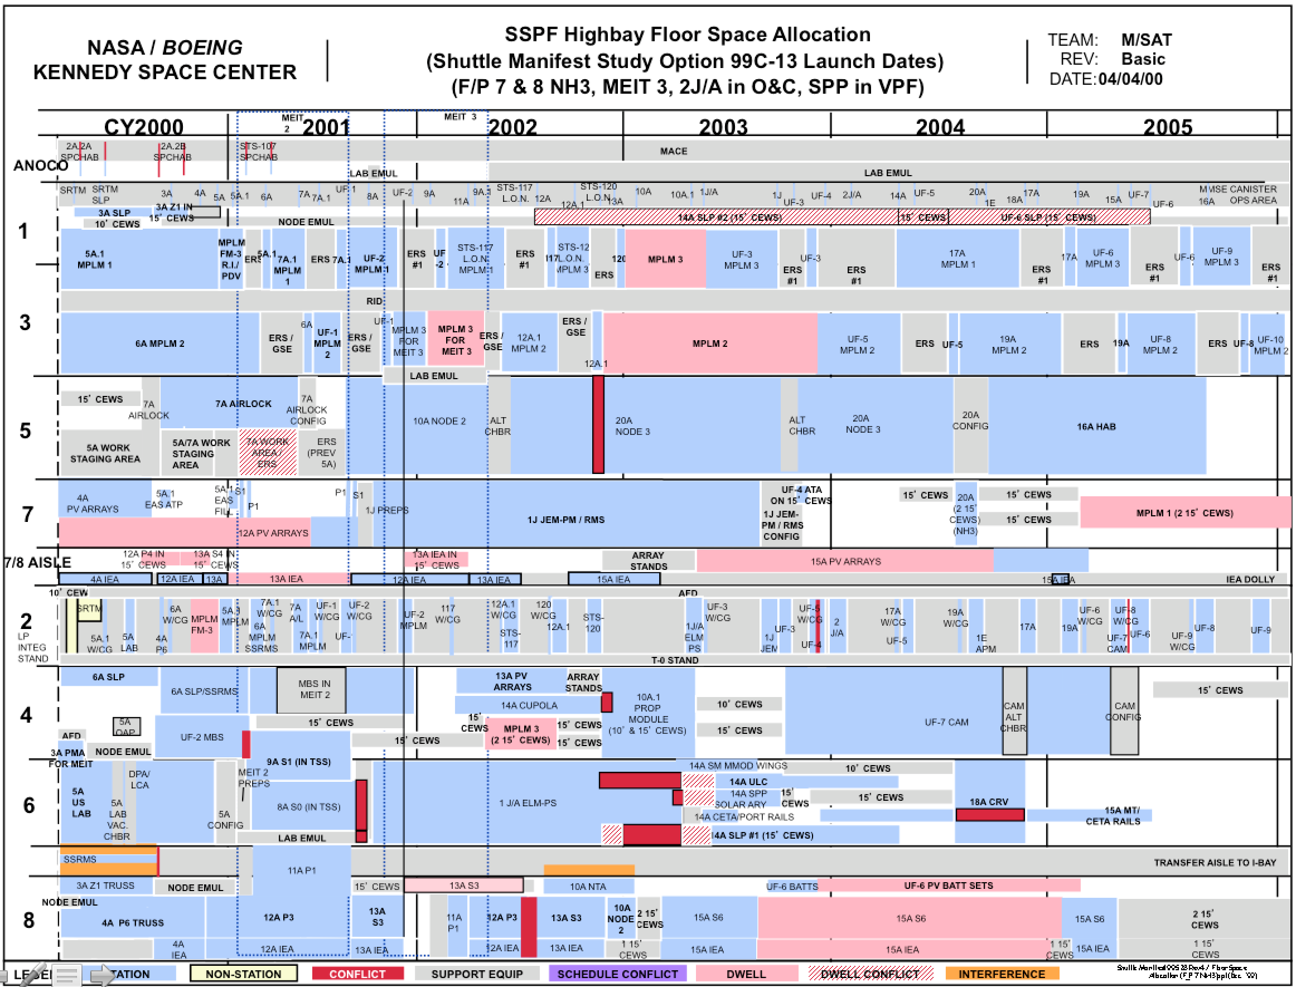

Slide 7
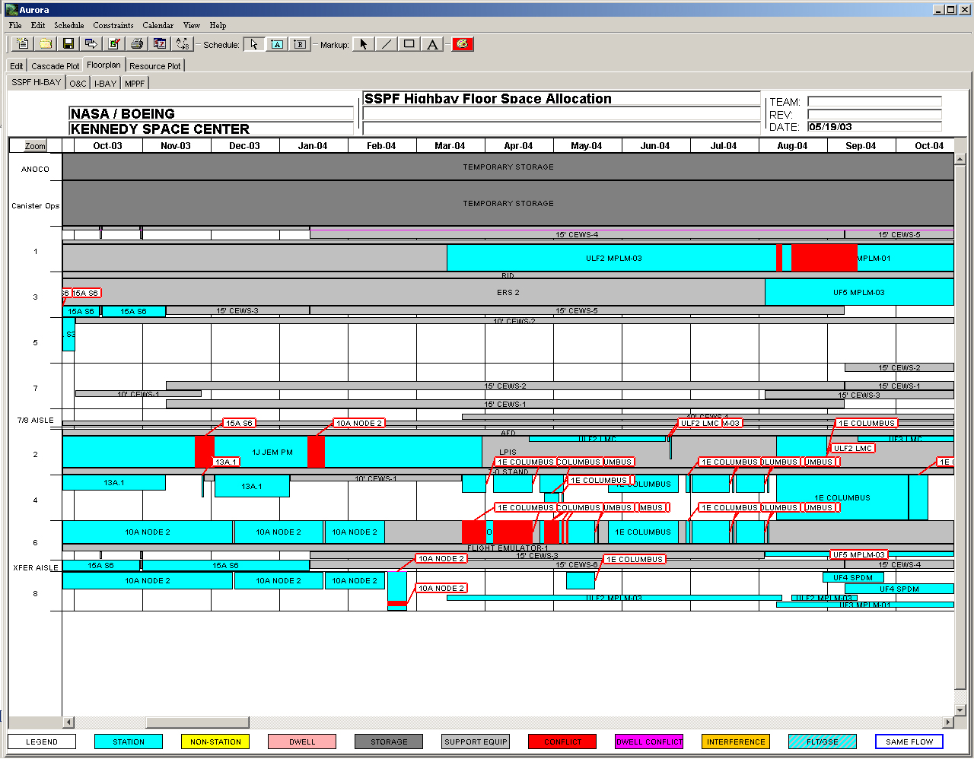

Slide 8
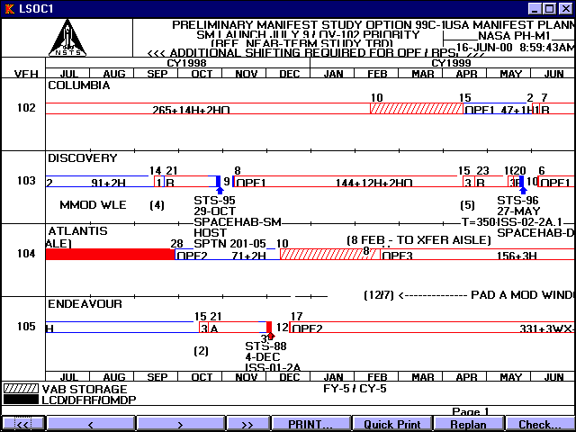

Slide 9
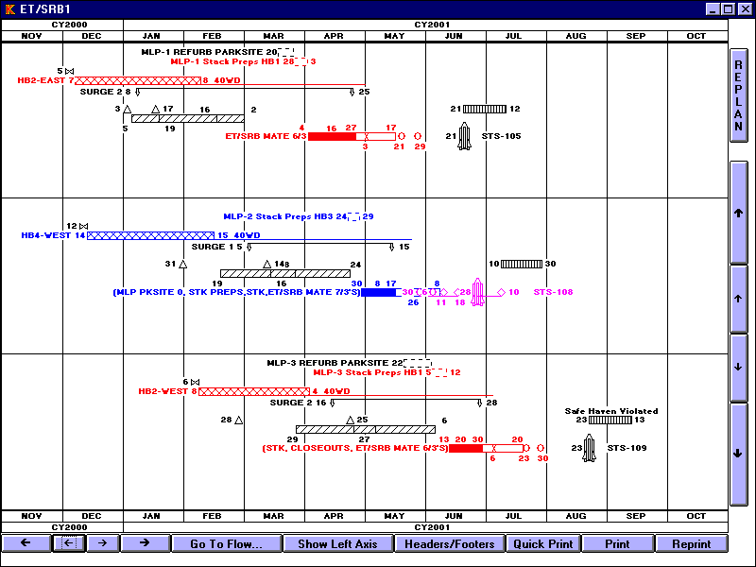

Slide 10
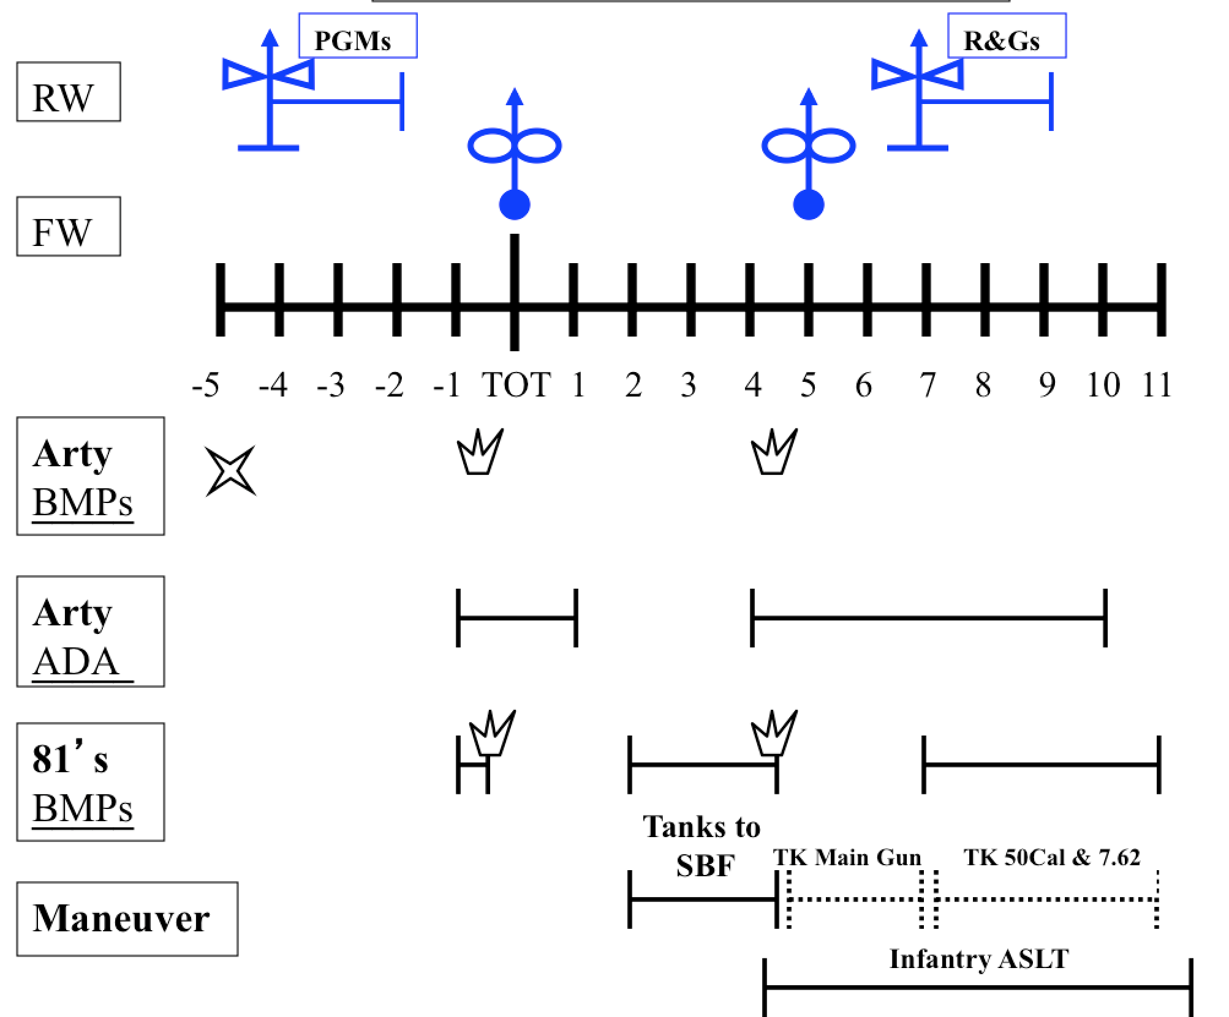

Slide 11
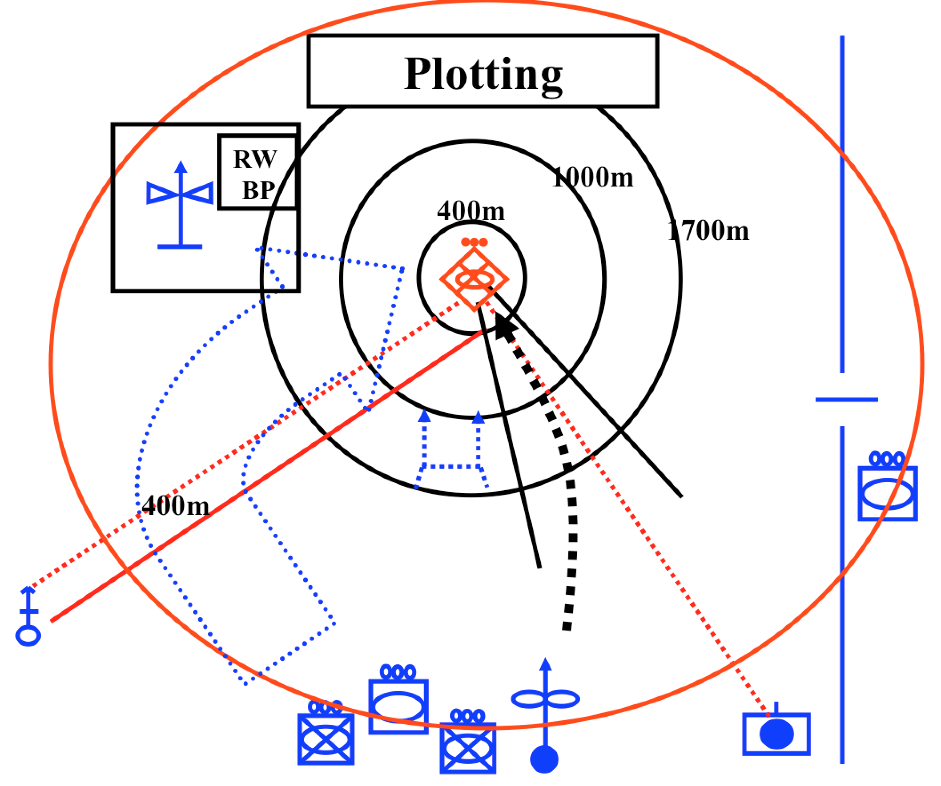

Slide 12
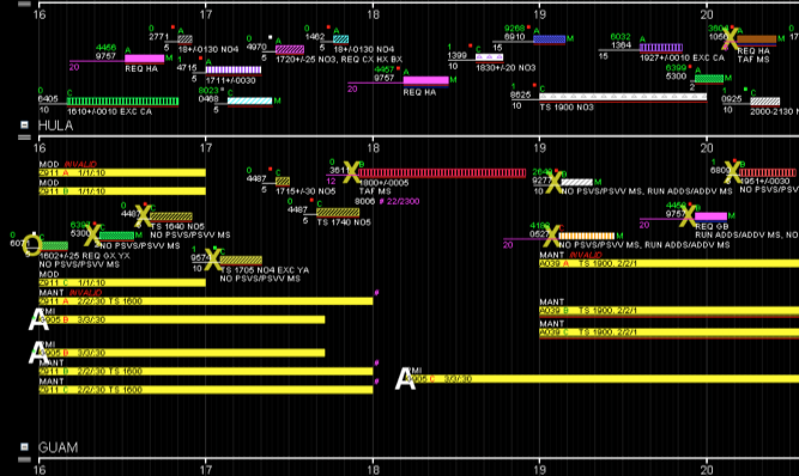
Satellite Communications Supports

Slide 13
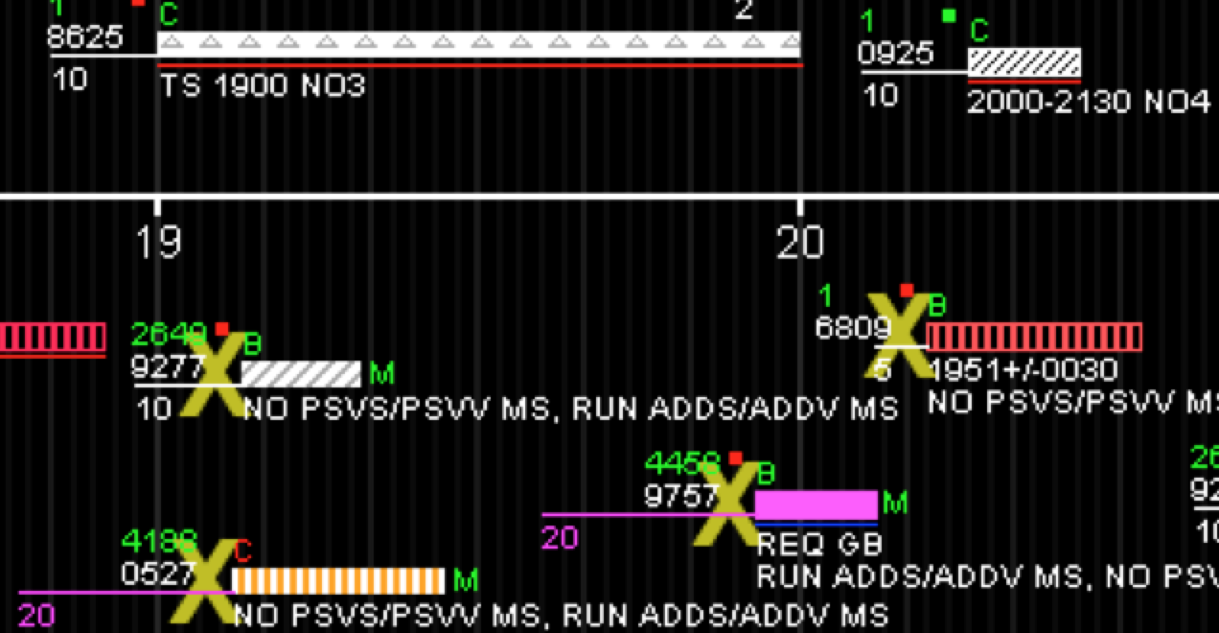
Satellite Support Decorations

Slide 14
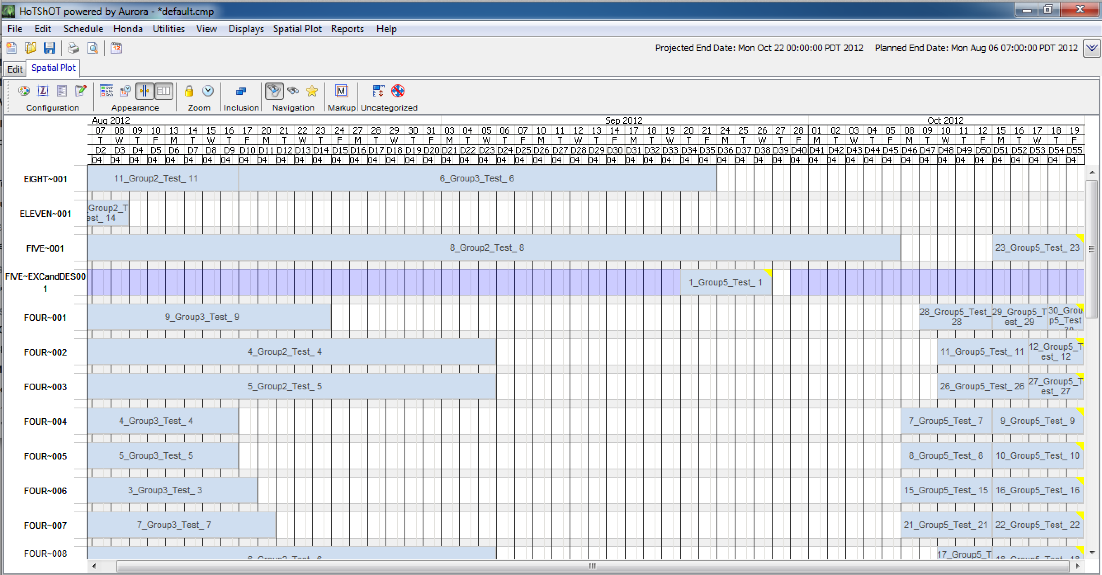
Honda Crash Testing Schedule

Slide 15
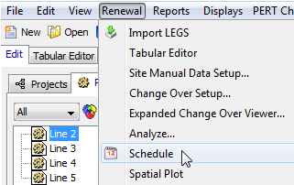
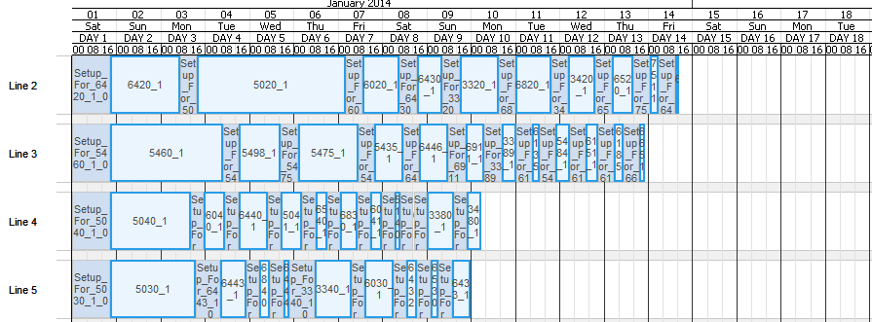
Pharmaceutical Manufacturing Schedule

Slide 16
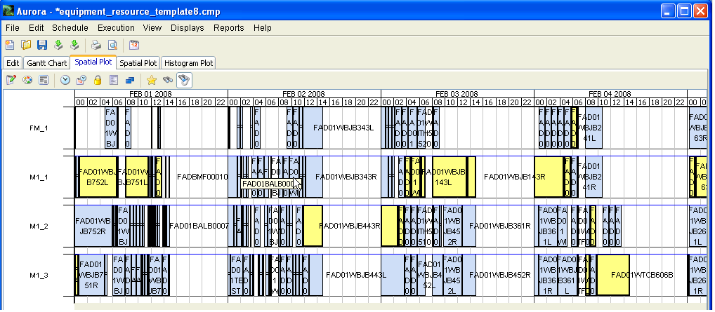
Manufacturing Resource Schedule

Slide 17
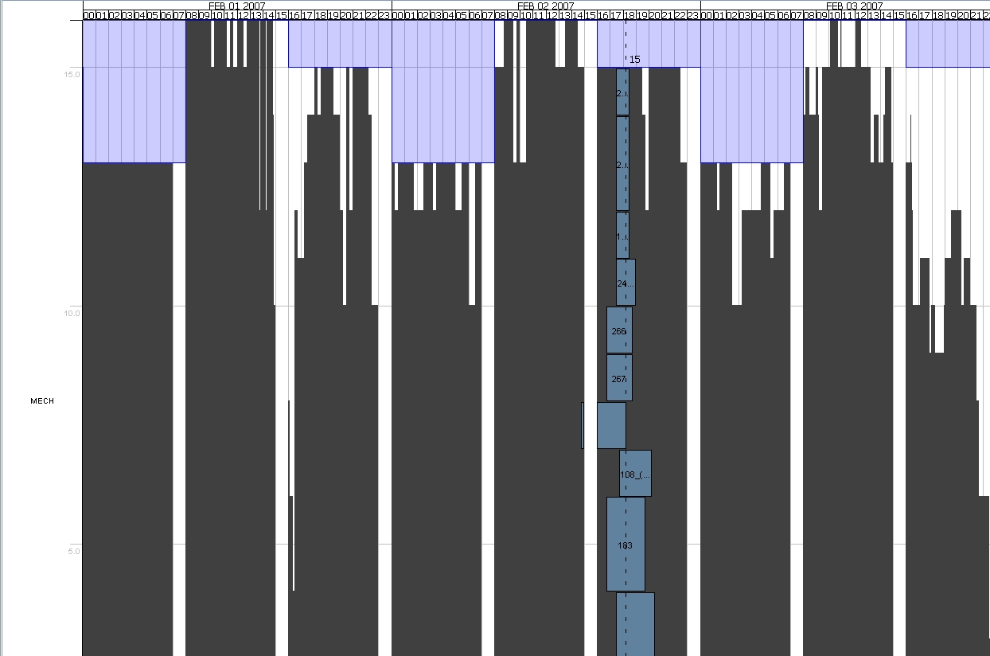
Histogram Exploration

Slide 18
Explanations/Trust (see quote above)
Why did it place the task here and not there?
Often software system is completely correct
Or possibly modeling error
But not initially believed
  “You can not automate me!”
  Human perception: “Main” versus “Minor” conflicts/constraints

Slide 19
Explanation Examples

Slide 20
Go with the (work) flow
Decentralized requesters / Centralized Schedulers
  Requests made by resource user organizations
  Resource manager schedule/deconflicts with suggested modifications which are sent to users for approval
  Users approve or further negotiate
Hierarchical Flow-Down
Phone vs E-mail vs Chat vs In-Tool vs External Tools
“Human” Annotations with initials
Sources of Data
Destinations/Transfer mechanisms of Schedule/Plan
  E.g. Primavera to transfer file to others
Import/Export to various formats

Slide 21
Work Flow (continued)
Human user – involved in real-time or deliberative P&S?
Scheduling frequency: 1 /year, 1/ month, 1/ day, 1/hour, constantly (real-time)
Time to react: 1 second?, 1 minute, 1 hour, 1 day?
Number of tasks: Dozens?, 100s?, 1000s?, more?
Technical Sophistication of End Users, What they do on the fly (e.g. reconfigure for analysis or re-planning)

Slide 22
Flexibility/Robust UI
New Capabilities => New Uses => New UI needed: Make UI robust and flexible for unanticipated changes
  What-ifs
  Outer Loop Optimization (Automatic or Manual)
  Expansion of domains: 787 to Tankers; Long Term Shuttles to Short Term Shuttles and SRBs
  Typically constant stream of enhancements
Schedule/Data Analysis features / User Sophistication
Lots of User Configuration Parameters (e.g. plot definition, filtering, colors, symbols) / User Sophistication
Keep UI completely separate from IP&S
UI Integration: Data Bus; Pub/Sub model
Threading Issues

Slide 23
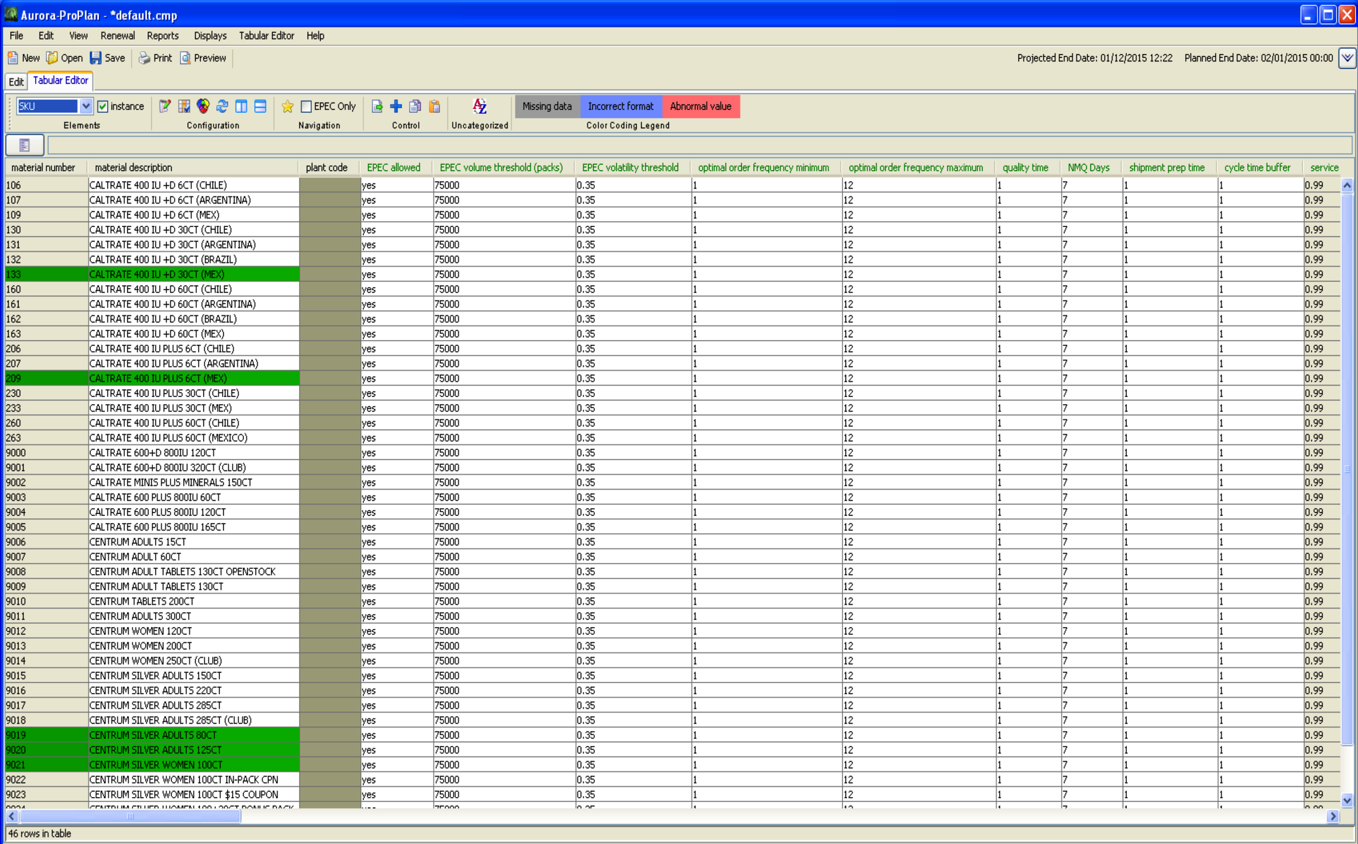
What-Ifs: Various Can be Performed
Change the demand for different SKUs
  Due to inventory & expiration dates
Change the working time of machines
Change changeover properties
Make changes in external data or in ProPlan
Update production schedule after changes in a matter of minutes

Slide 24
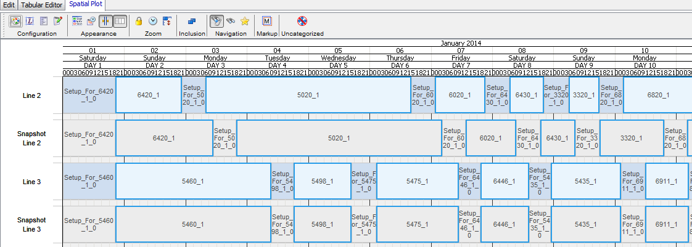
What-If Capabilities
The user can manually add/remove machines or change calendars to see the effect on the schedule.
Notes:
Comparing a schedule to a snapshot of a previous schedule. The current schedule, shown with blue shading, has a higher throughput for products 6420 and 6020. The baseline schedule, shown in gray, has a lower throughput for products 5020 and 6020 and hence the production times are longer.

Slide 25
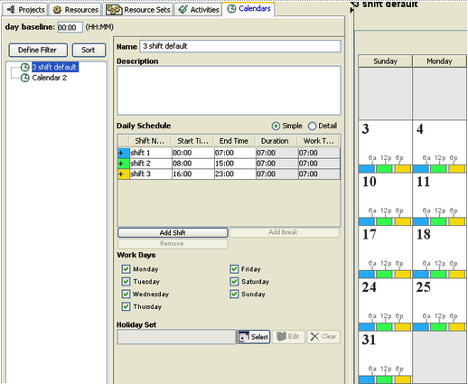
Complete Calendar Support
Notes:
Comparing a schedule to a snapshot of a previous schedule. The current schedule, shown with blue shading, has a higher throughput for products 6420 and 6020. The baseline schedule, shown in gray, has a lower throughput for products 5020 and 6020 and hence the production times are longer.

Slide 26
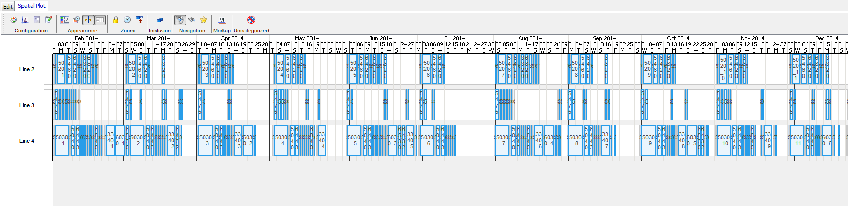
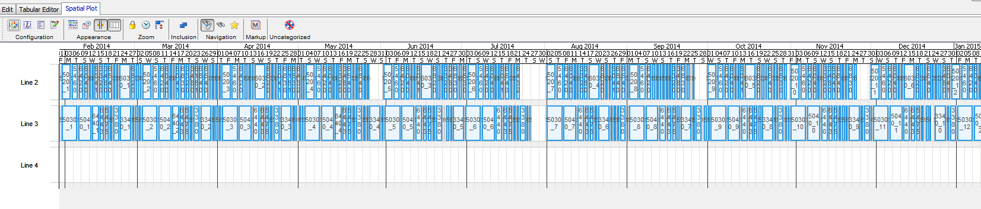
What-If: Same Demand 3 vs 2 Lines

Slide 27
Conflicts
Conflicts will occur if there are not enough lines / machines
  Conflicts shown in red
Notes:
Same set of tasks, but with several lines removed. Conflicts where Aurora is unable to complete all of the given tasks by the due date are shown in red. These conflicts can be resolved by adding resources (e.g. making another line available) or relaxing constraints (e.g. allowing a later due date for one or more SKUs).

Slide 28
Removing Capacity Without Causing Conflicts

Slide 29
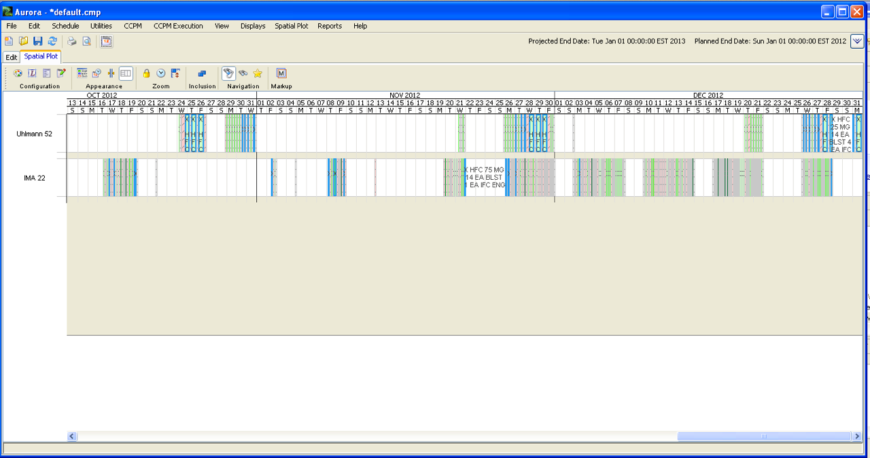
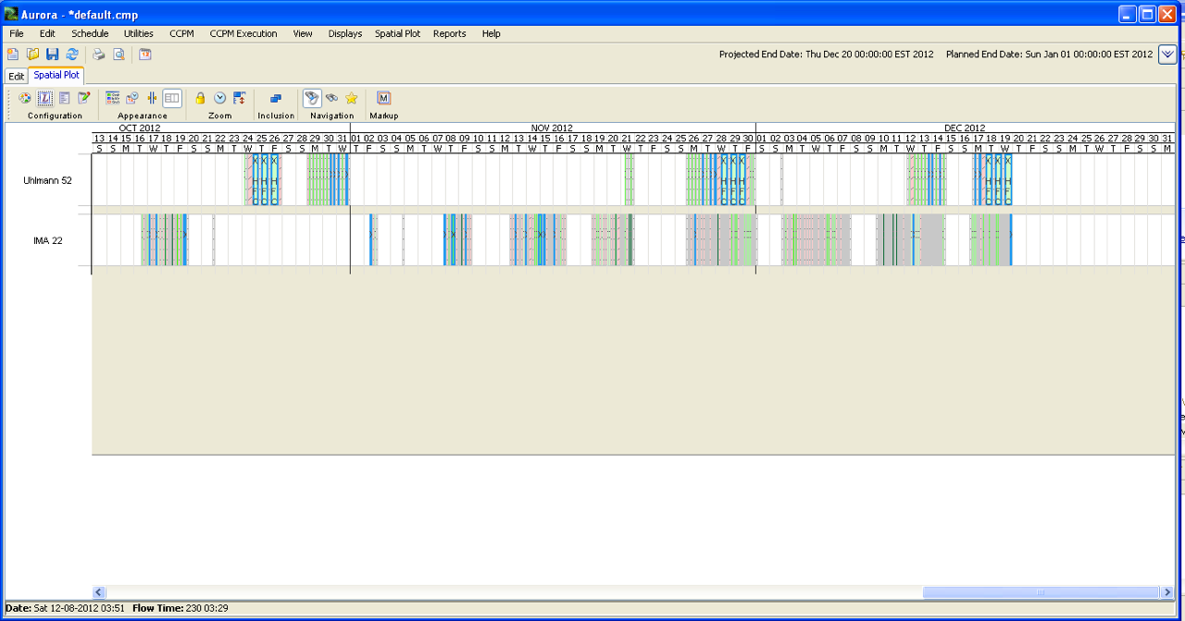
What-if: End of Year Shutdown

Slide 30
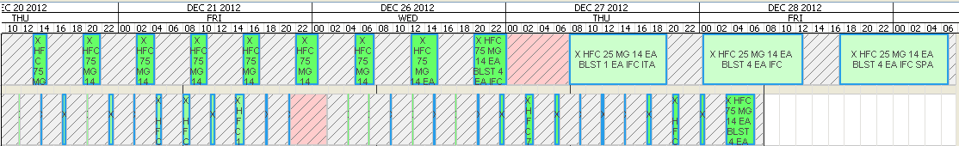
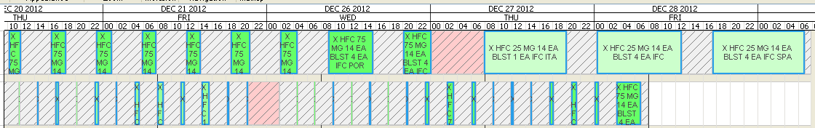
What-if: Demand Increase

Slide 31
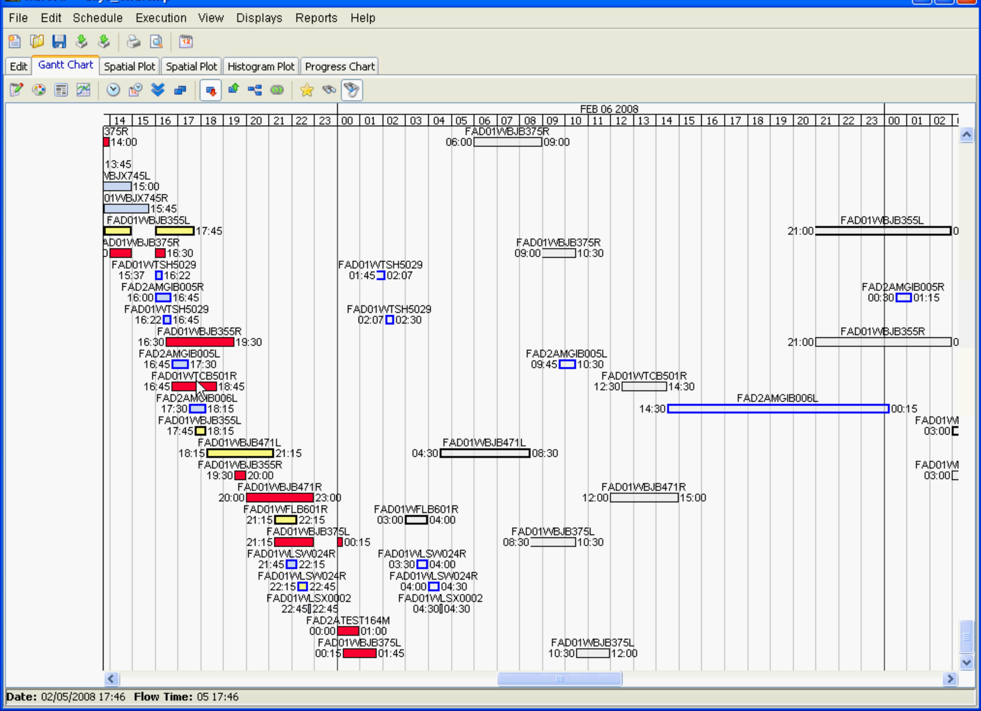

Slide 32
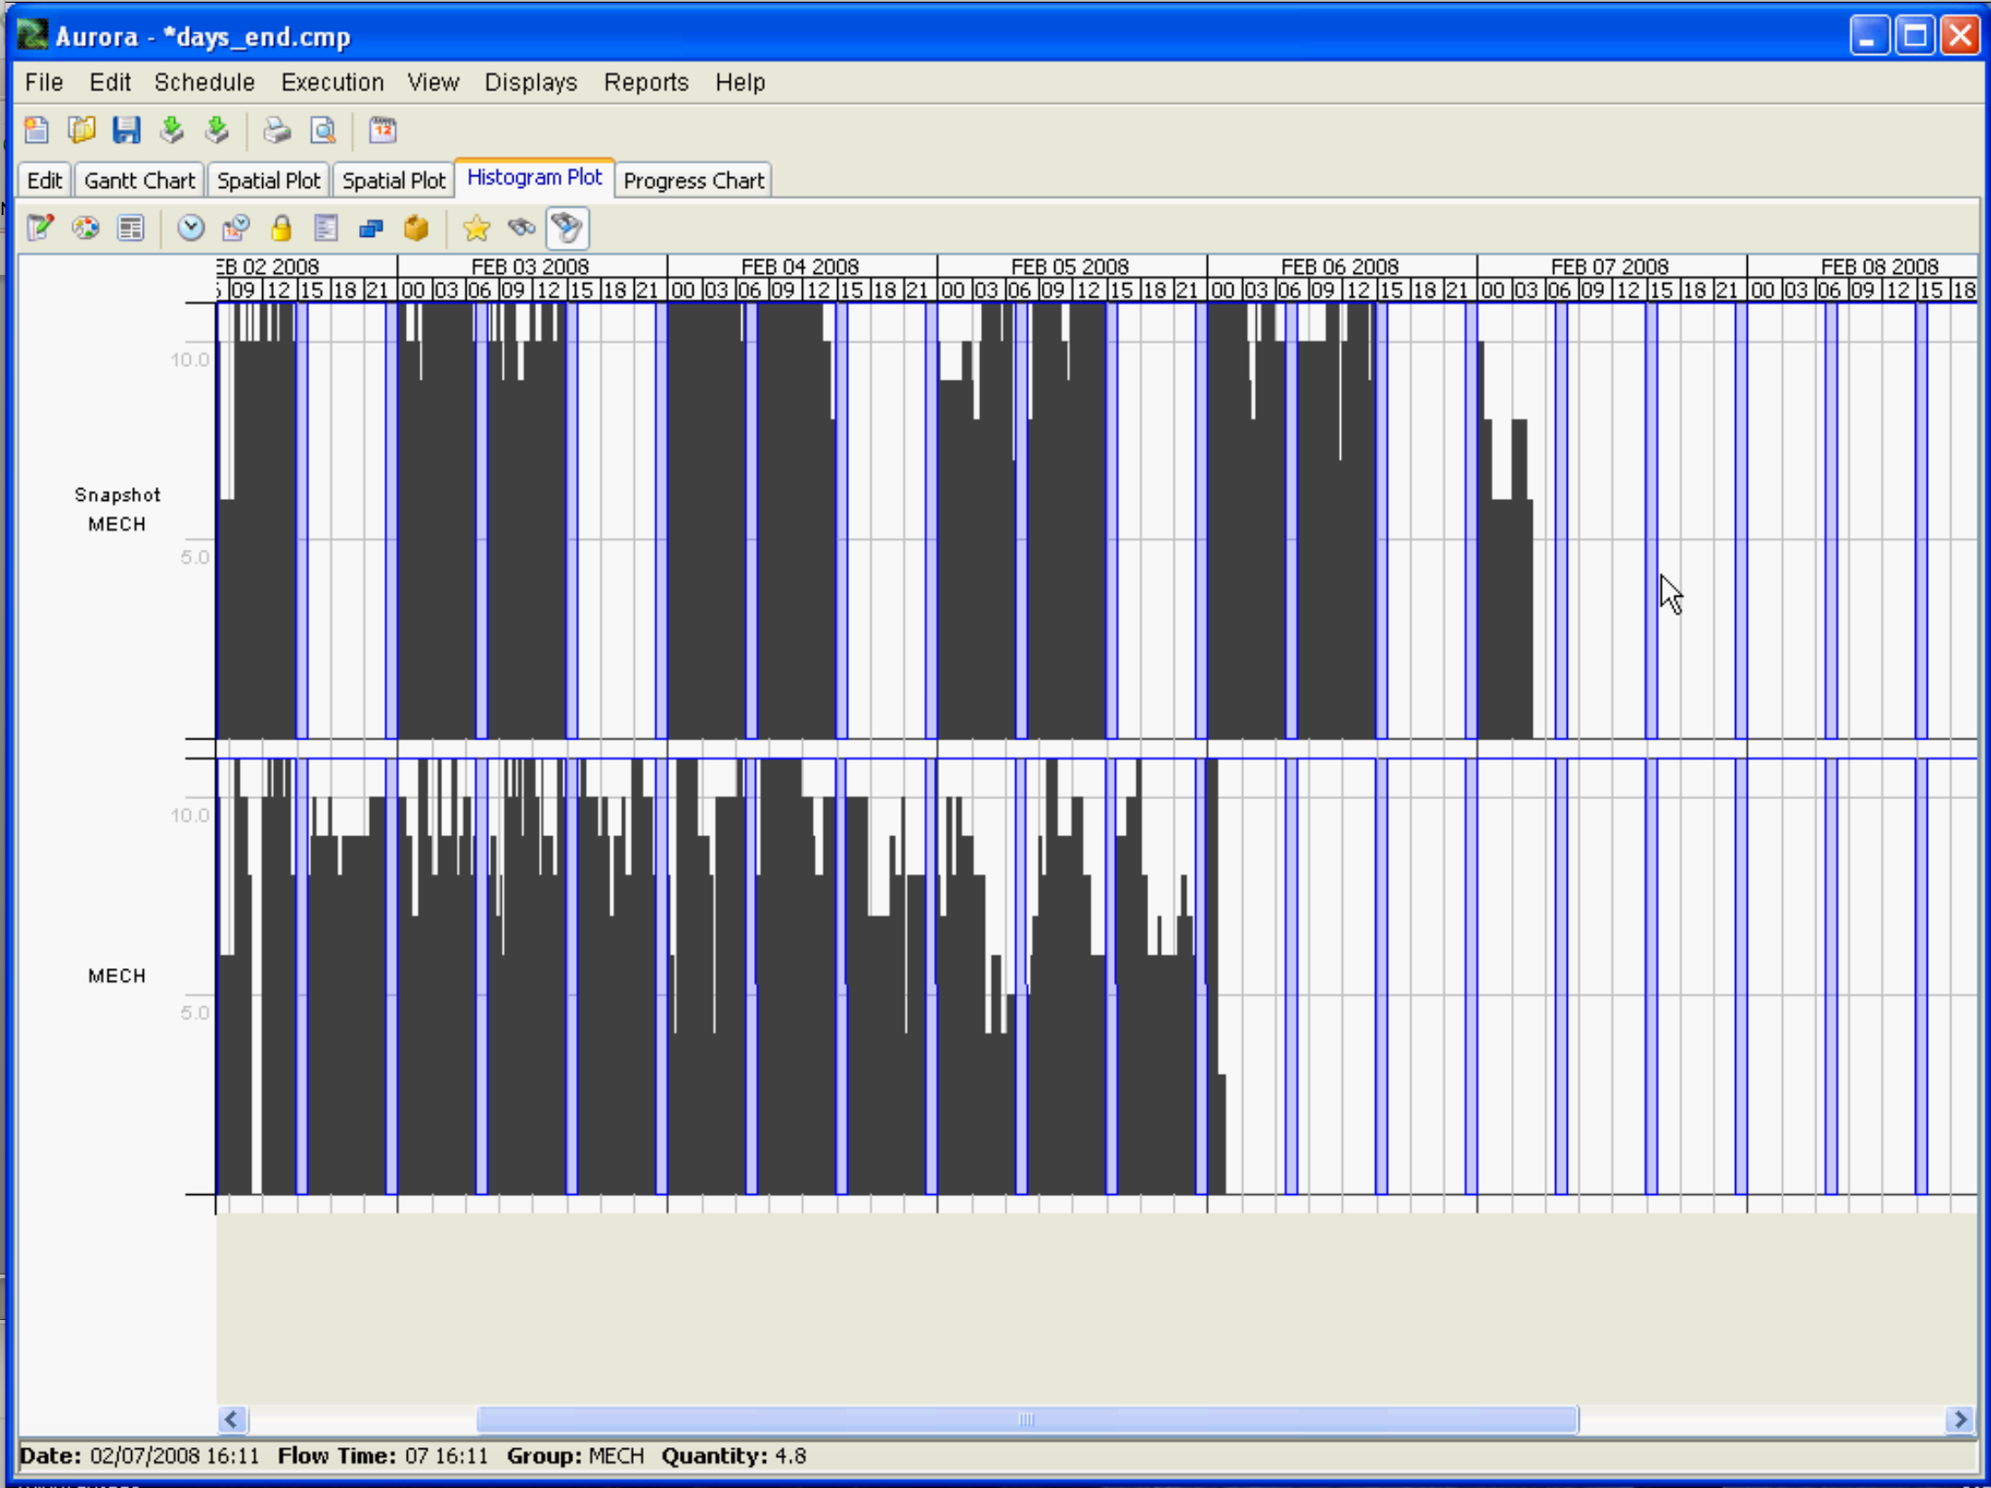

Slide 33
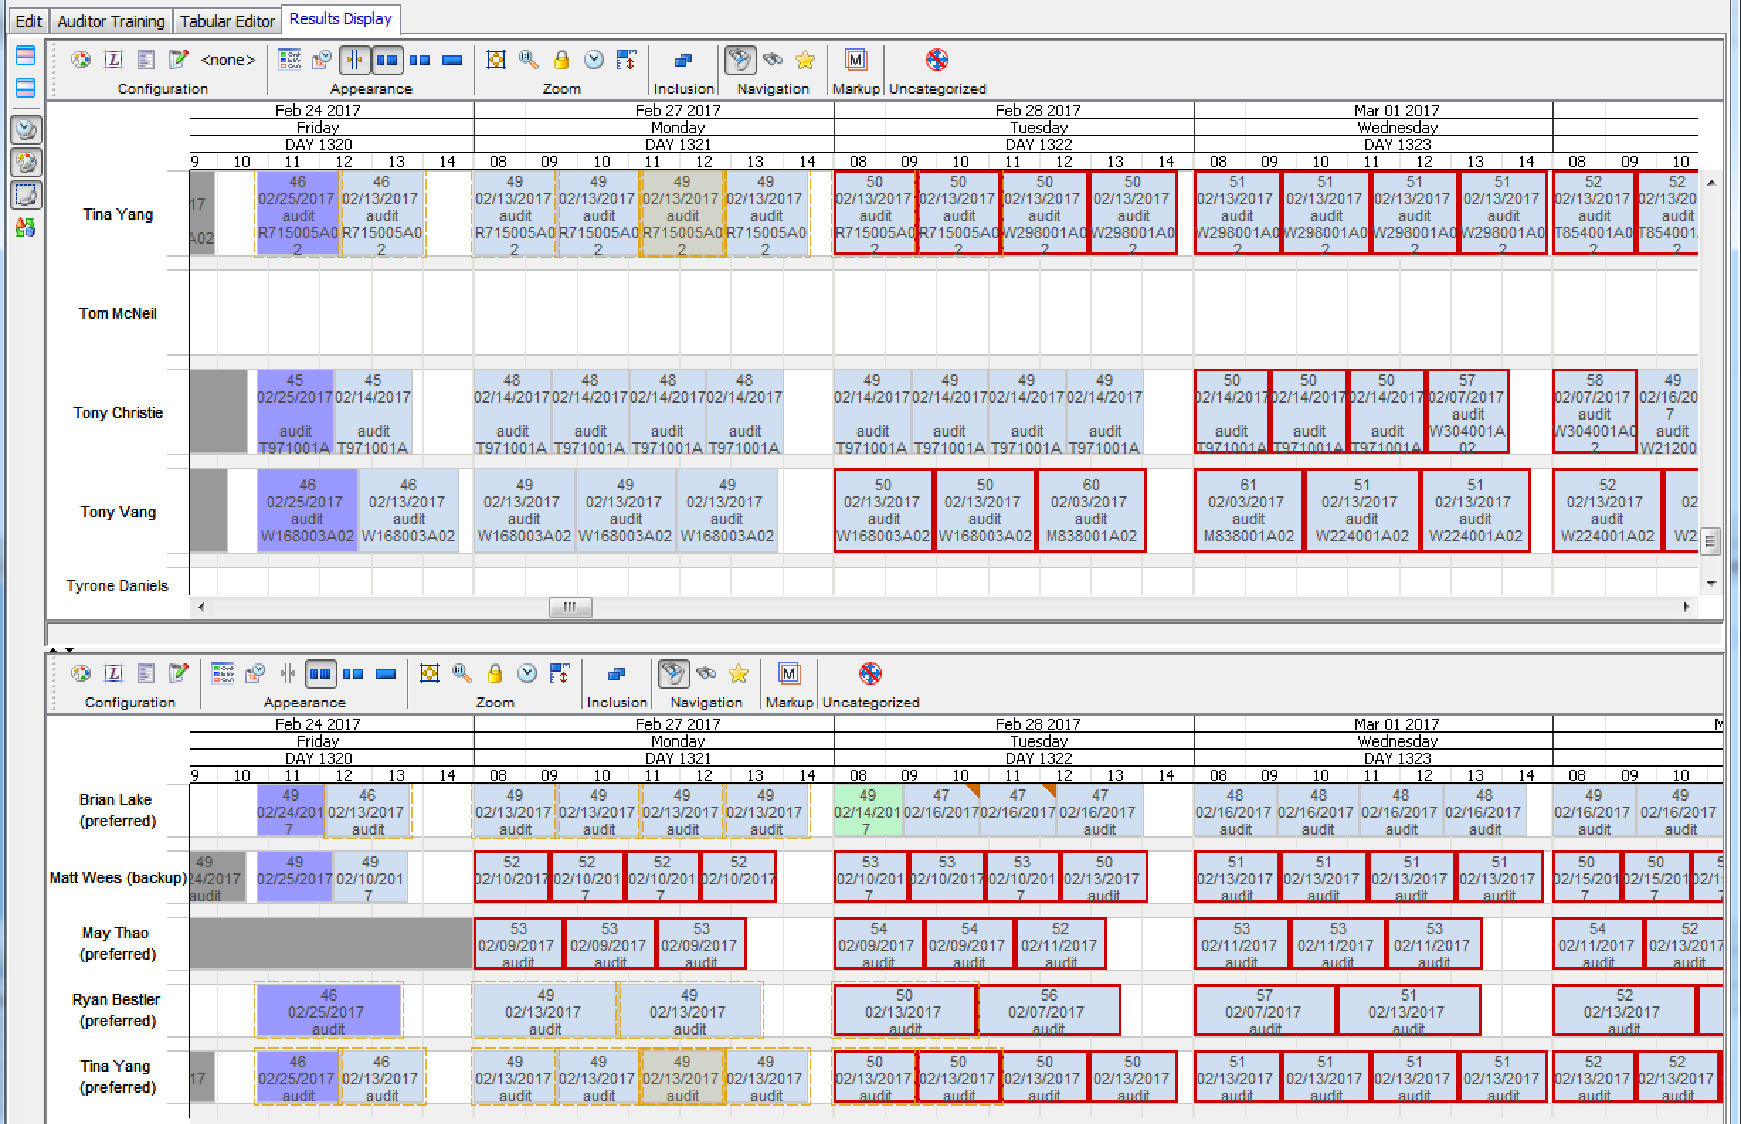
Viable Personnel Visualization
Small Acceptable Set (small range of possible personnel; two are working a different/late set of work)

Slide 34
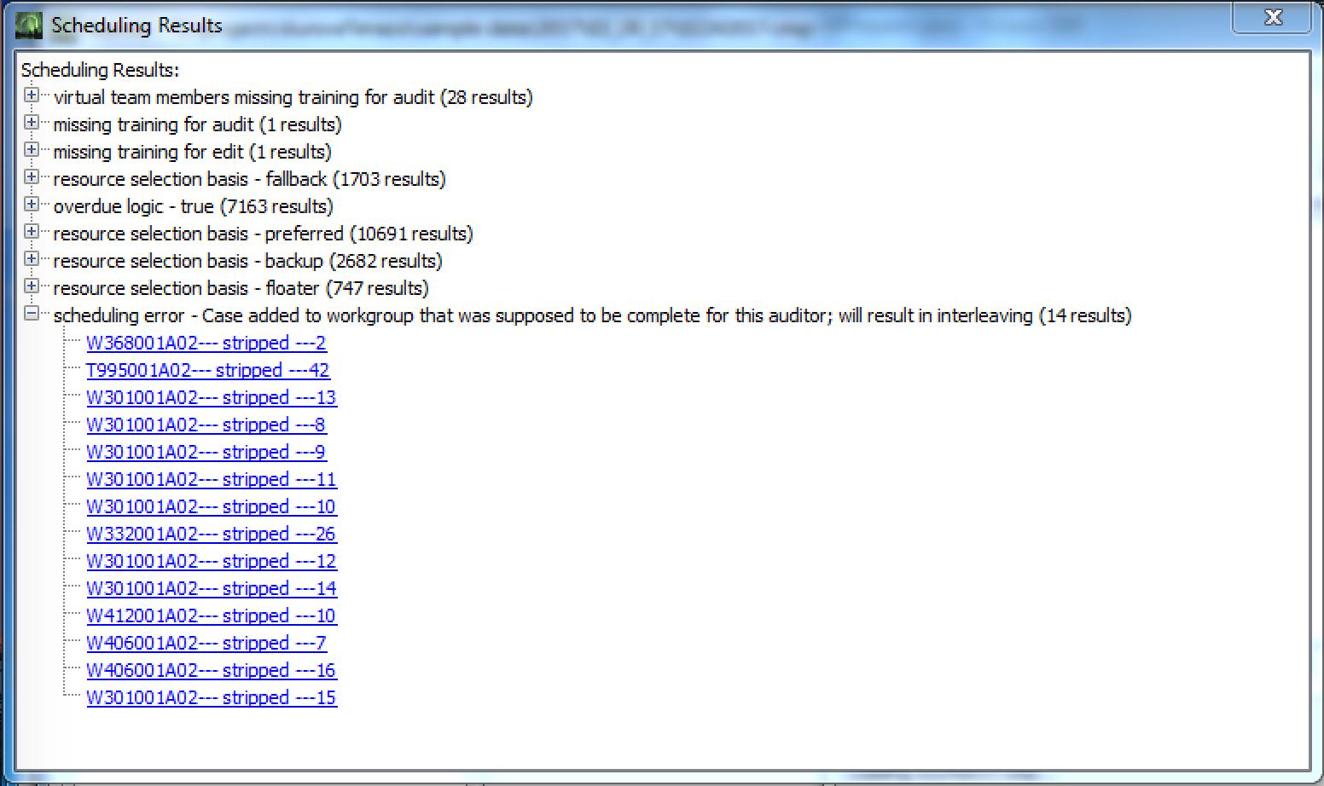
Issue Management –
Schedule Report

Slide 35
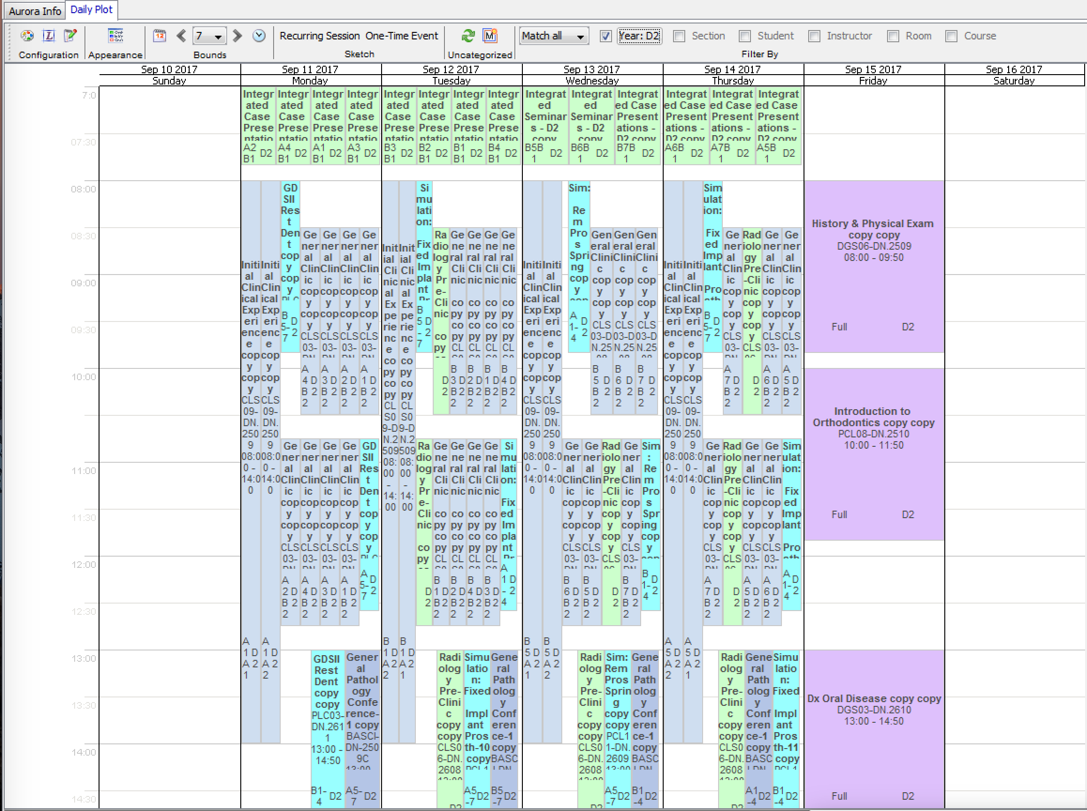
Calendar Plot
Easy configuration via common filter options – see upper right (currently filtered for D2)

Slide 36
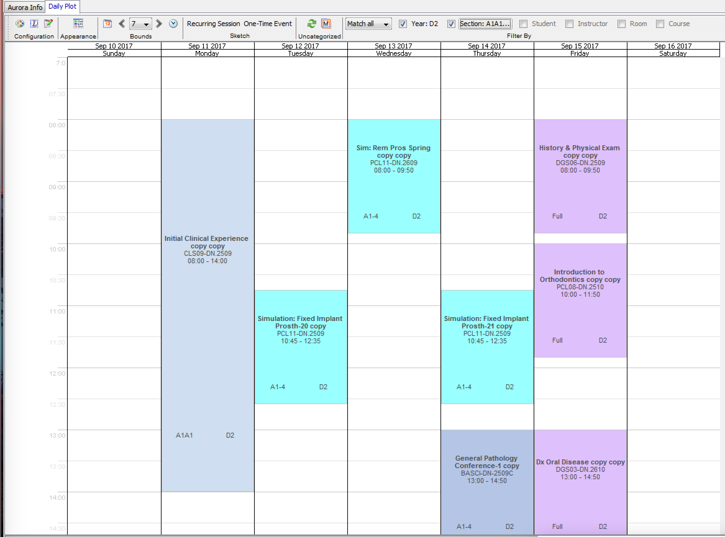
Calendar Plot
Added filter for section (shows schedule for one subset of students in the class)

Slide 37
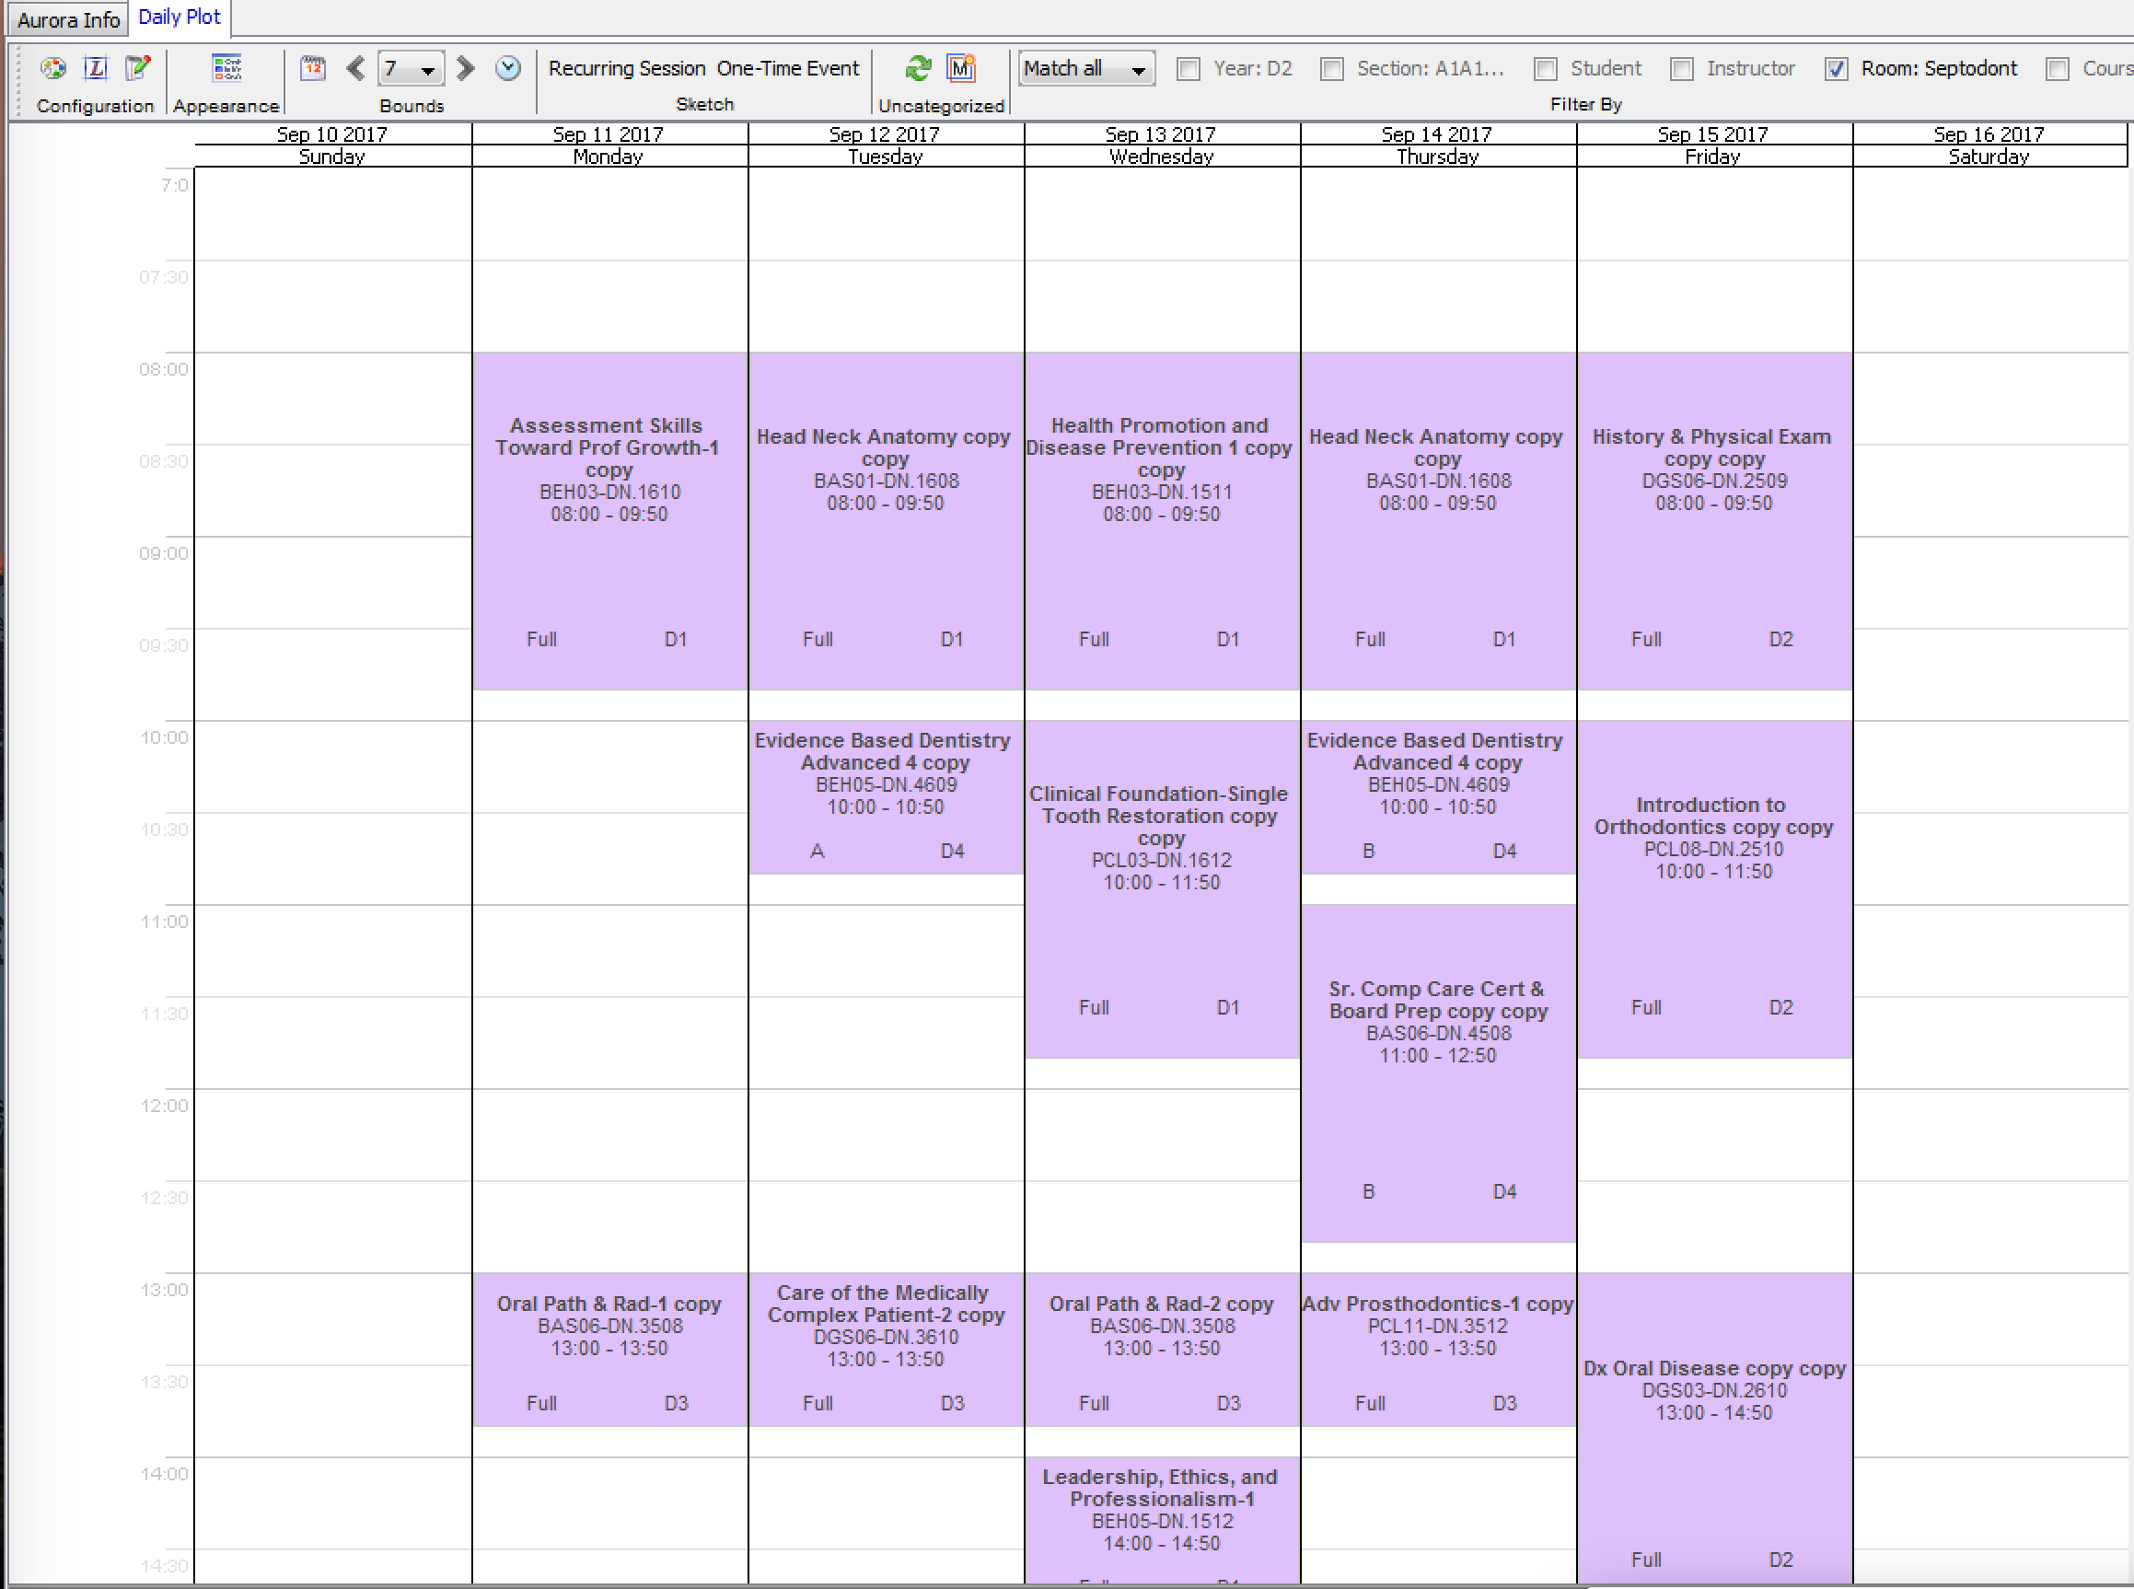
Calendar Plot
Same timeframe; filtered by room

Slide 38
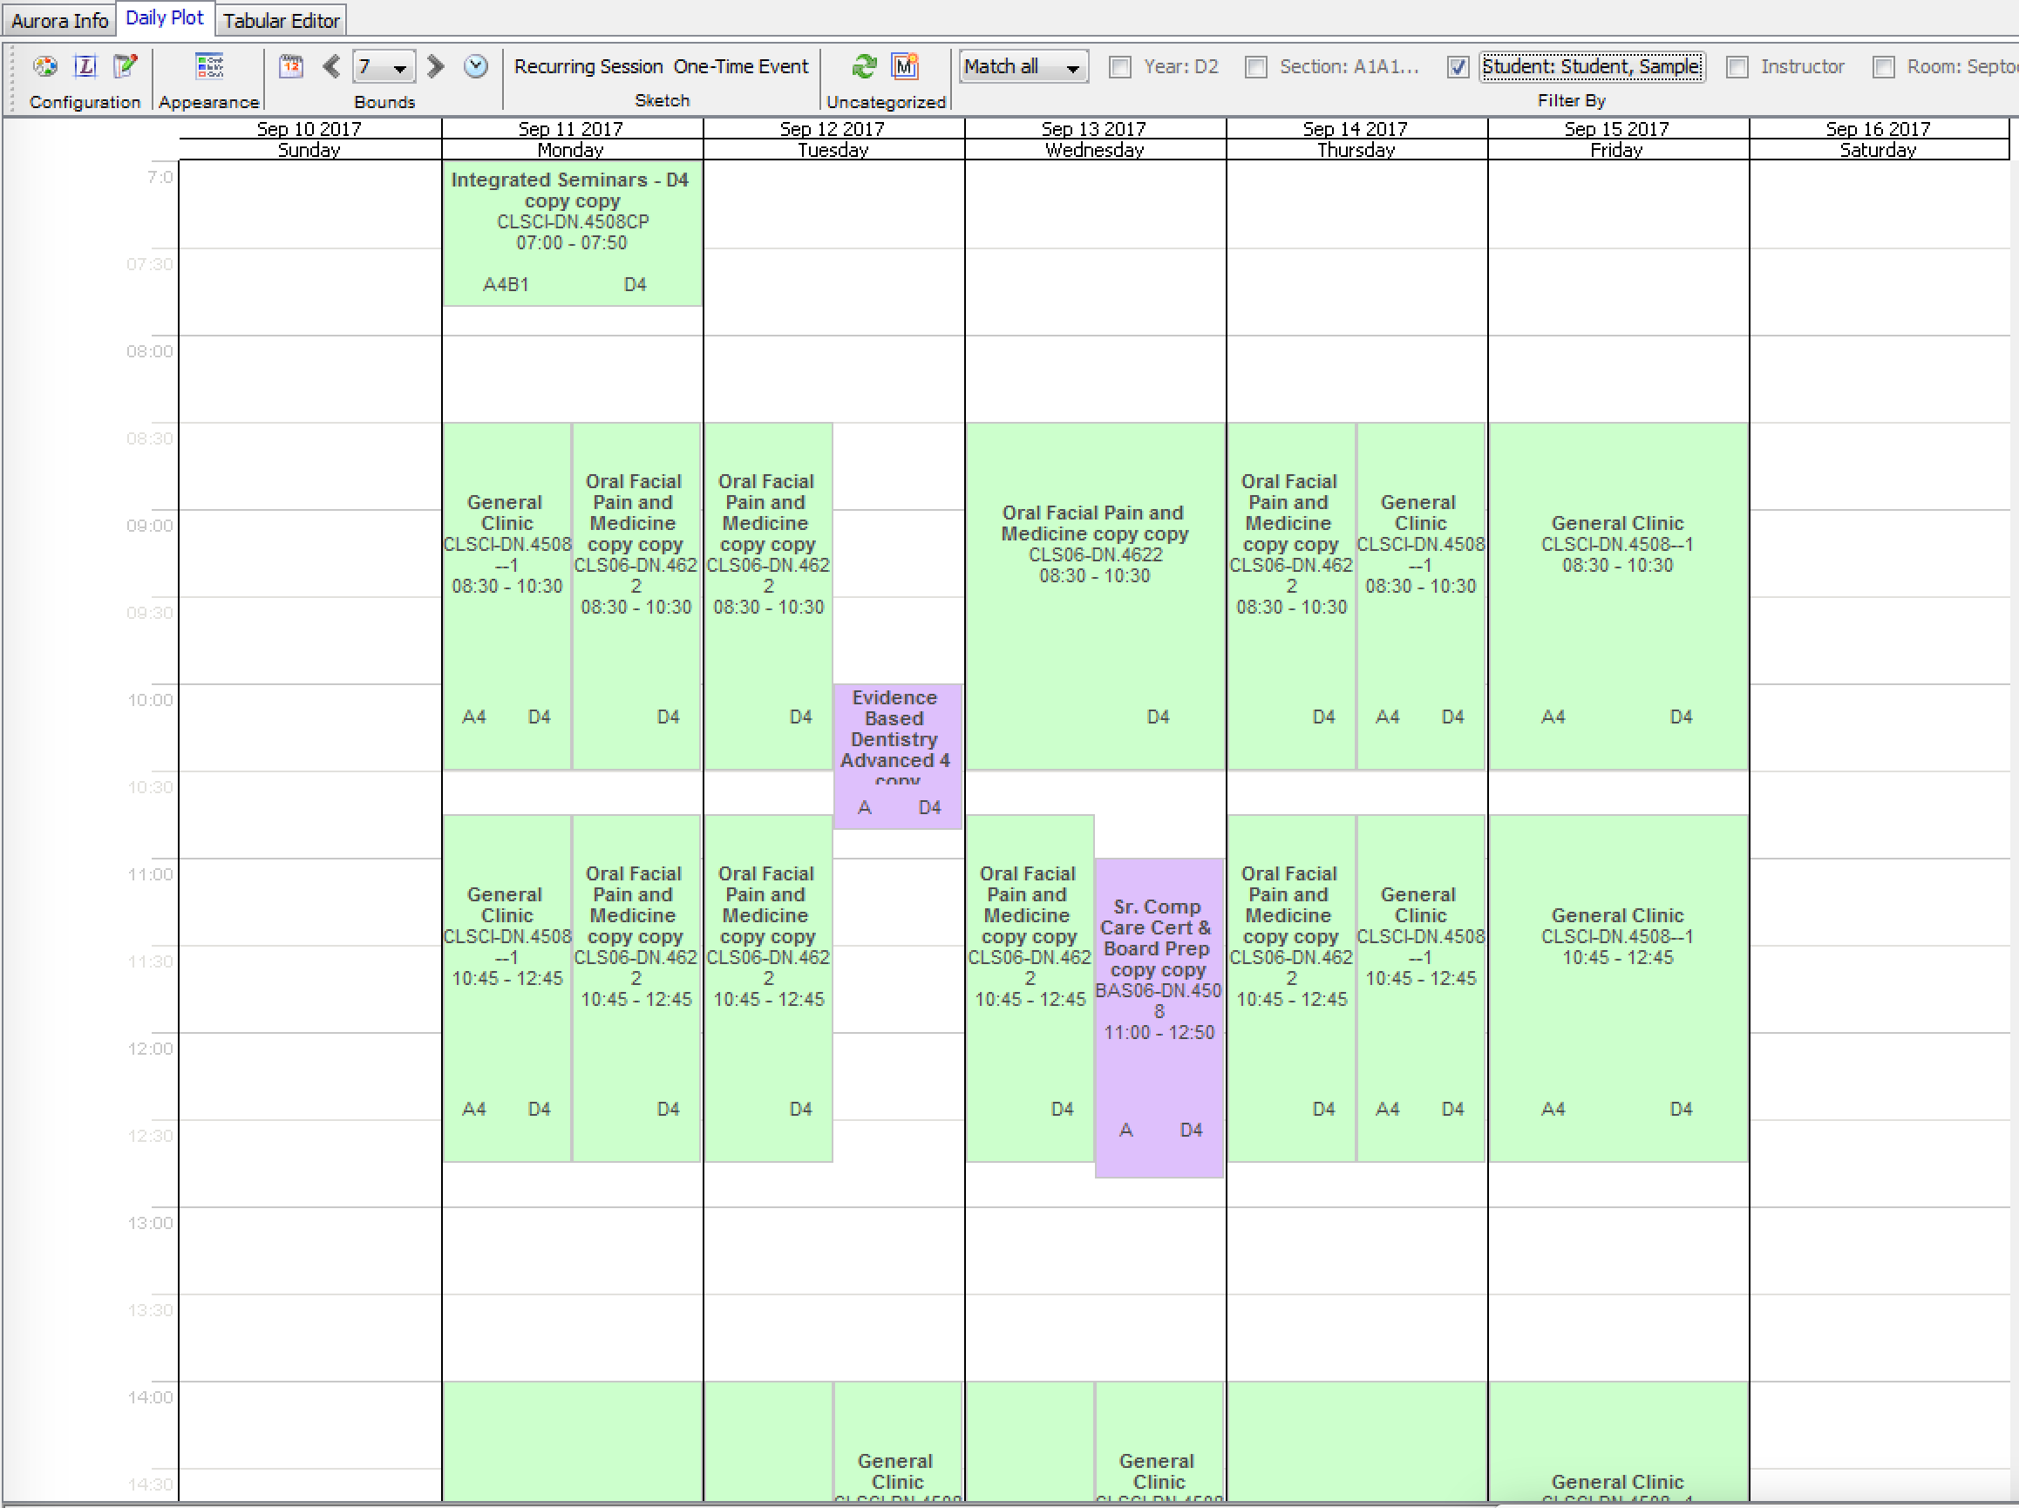
Calendar Plot
Same timeframe; filtered by student (overlapping allocations reflect “preemptions” where student is pulled from one experience to engage in another experience)

Slide 39
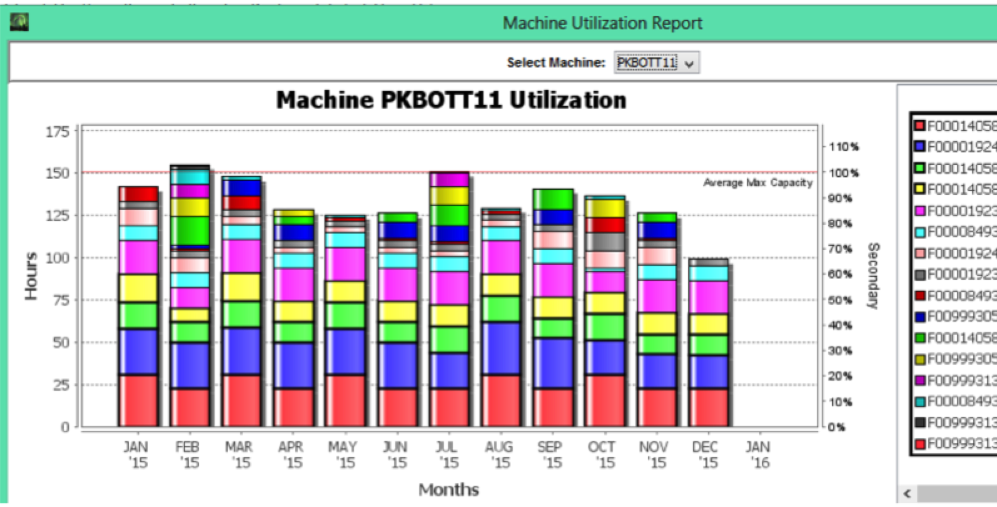
Pharmaceutical Manufacturing
Machine Utilization Report
Shows overall utilization of products by line
Allows planners to see overall allocation and line balancing

Slide 40
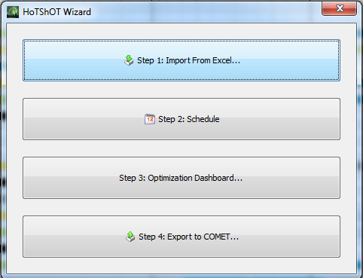
Vehicle Crash Testing Wizard (very easy to use interface (especially for low frequency user tasks)
Notes:
ERROR: Task has a longer duration (90) than the available work days (46).
WARNING: Model contains 4043 days of tasks but only 3851 available vehicle-days. This will likely be fixed during the optimization phase.

Slide 41
User Acceptance Requirements
Sometimes you just got to do it
Things you don’t want to do, some push back then just do it
E.g. Artemis Interface / Never Used
Do you want to be right or do you want it fielded?
  Doesn’t impact IP&S Algorithm (the thing you care about)
Examples
  Left versus bi-directional No-X constraints
  1980s DOS style interface
  EXACT font/icon match on printed schedules

Slide 42
Legacy System Integration
May or may not be UI related
  I.e. a good alternative to data entry or to avoid re-implementing UI
  E.g. Primavera front-end/UI for NASA SLS & Construction Industry
E.g. Boeing’s Automatic Dreamliner Scheduler
  CMAD, Boeing Data Warehouse
    Official work statement and progress
    Jobs/Characteristics, Calendars, Resources, Resource Requirements, Constraints
    Many upstream data sources
  Velocity Shop Floor Management System
    Upcoming Jobs/Assignments/Constraints
    Many downstream data destinations
  Boeing’s Schedule Editor
  JSS Underlying DB supplied by CMAD, used by Schedule Editor
    User can have Aurora dump to JSS
  Oracle – flexible data dump

Slide 43
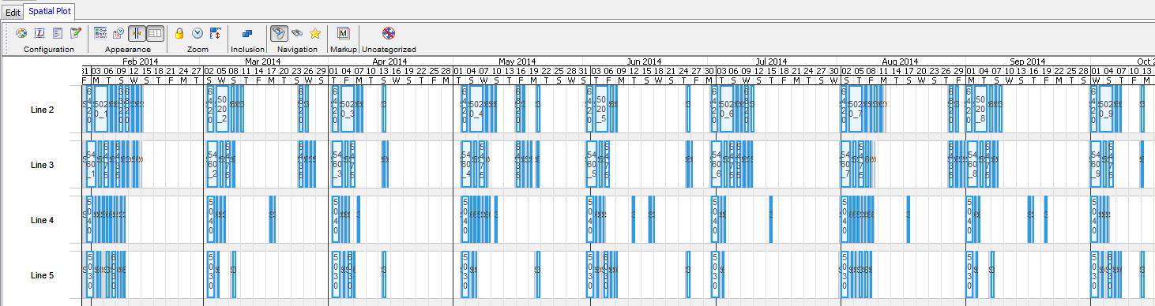
Pharma Intelligent Scheduling
Production Data (Vol. Reqs, Resources
→ Aurora-ProPlan
→ Production Schedule
→ Export (for execution)
Notes:
Aurora can model the unique constraints found in Pharma, including the overhead of many changeovers.
Another example, is that Aurora includes flexible calendar functionality, so all the workers, machines, or any entity in the model can have its own calendar and this calendar can be updated at anytime. For example, update immediately the calendar for a machine that goes down and is planned to be unavailable for 5 days.

Slide 44
Different Domains => Different Conflict Concepts => Different UI
Time: Rigid (e.g. Shuttle Processing) vs Flexible/Padded (e.g. Sat. Support Prep.) vs Likely Slip (HW deliveries)
Resources
  Individual: Required (Antenna) vs Optional (Secure Voice)
  Real-Valued: Padded (e.g. Floor Space) vs. Rigid (Electrical Power)
  “Over” shareable (E.g. Bandwidth, won’t need all, all of the time)
Representations/Displays of Conflicts: Overlaps/Colors
Politics; Sometimes Schedules are Political Documents
“Editing”: Forcing versus Leaving / Show Conflicts or Not
Human perception: “Main” versus “Minor” conflicts/constraints
Every domain is different, likely different algorithms and definitely different UIs (optimized to the specific domain)

Slide 45
User editing “final” product / replanning
Recall on-purpose semi-modeled domain
  Therefore result will be suboptimal
Allowing for user editing of the results, then re-planning
  Question: To honor or not to honor edits
  Replanning “around” the user change
  Implicit/explicit time/resource scope of replanning
  Absolute vs “relative” freezing of user edits
  Which user edits to keep vs undo by replanning
Major impact on user efficiency/acceptance
  Possible (partial) solution to “ask” at time of edit
  Visual Indication of what will “stick”

Slide 46
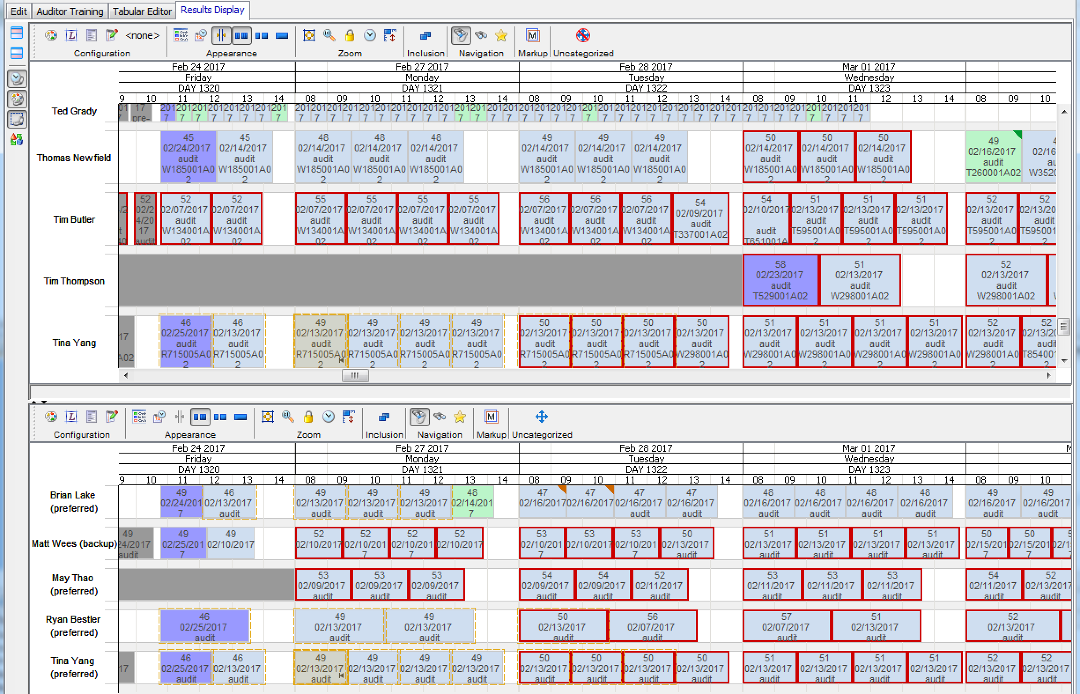
Selected activity was dragged, schedule was updated
(note pin icon)

Slide 47
Special UI Challenges with truly distributed / mixed initiative planning and scheduling
Obviously will have an edit-lock system
  Distributed editing can interact badly with relaxing (to resolve conflict) (E.g. “Forcing”) and/or widely-impacting constraints (E.g. No X in a row at the same site constraint)
Resolving same conflict from different sides of it
Consistency globally and in User’s perception
Autonomous schedule updating
Human tolerance to change, partly time-until based, but not completely / ~Arbitrary changes can cause distress
  Err on the side of leaving things alone
  Point to where task “moved” to (time/resource/display)

Slide 48
Future IP&S UI Work
New modalities (e.g. voice, VR)
Careful – efficiency!!!
(Few or one) words faster than clicks/drags
  E.g. Click support and say “Hula-B”
Make two steps in series be done in parallel
  E.g. Say “B” as you move to Hula
60 to 90 days digital skills 100% decayed away
  “Show me how to do X” (E.g. create a mission impact report)
“What’s the bandwidth at Hula” (for novices)
VR – 3D representation/moves instead of 2-D

Slide 49
Summary
“It enables us to generate complex schedules in a few hours, compared to days or weeks required by our previous scheduling systems.” - Tom Overton, NASA KSC Mission Planning Office, 1993.
General Good UI Design Principles
Explanations/Trust (see quote above)
Go with the (work) flow
Flexibility/Robust UI
User Acceptance Requirements (See title above)
Legacy System Integration
Different domains = Different Conflict concepts
User editing “final” product / replanning
Special UI Challenges with truly distributed / mixed initiative planning and scheduling

